Slide 1
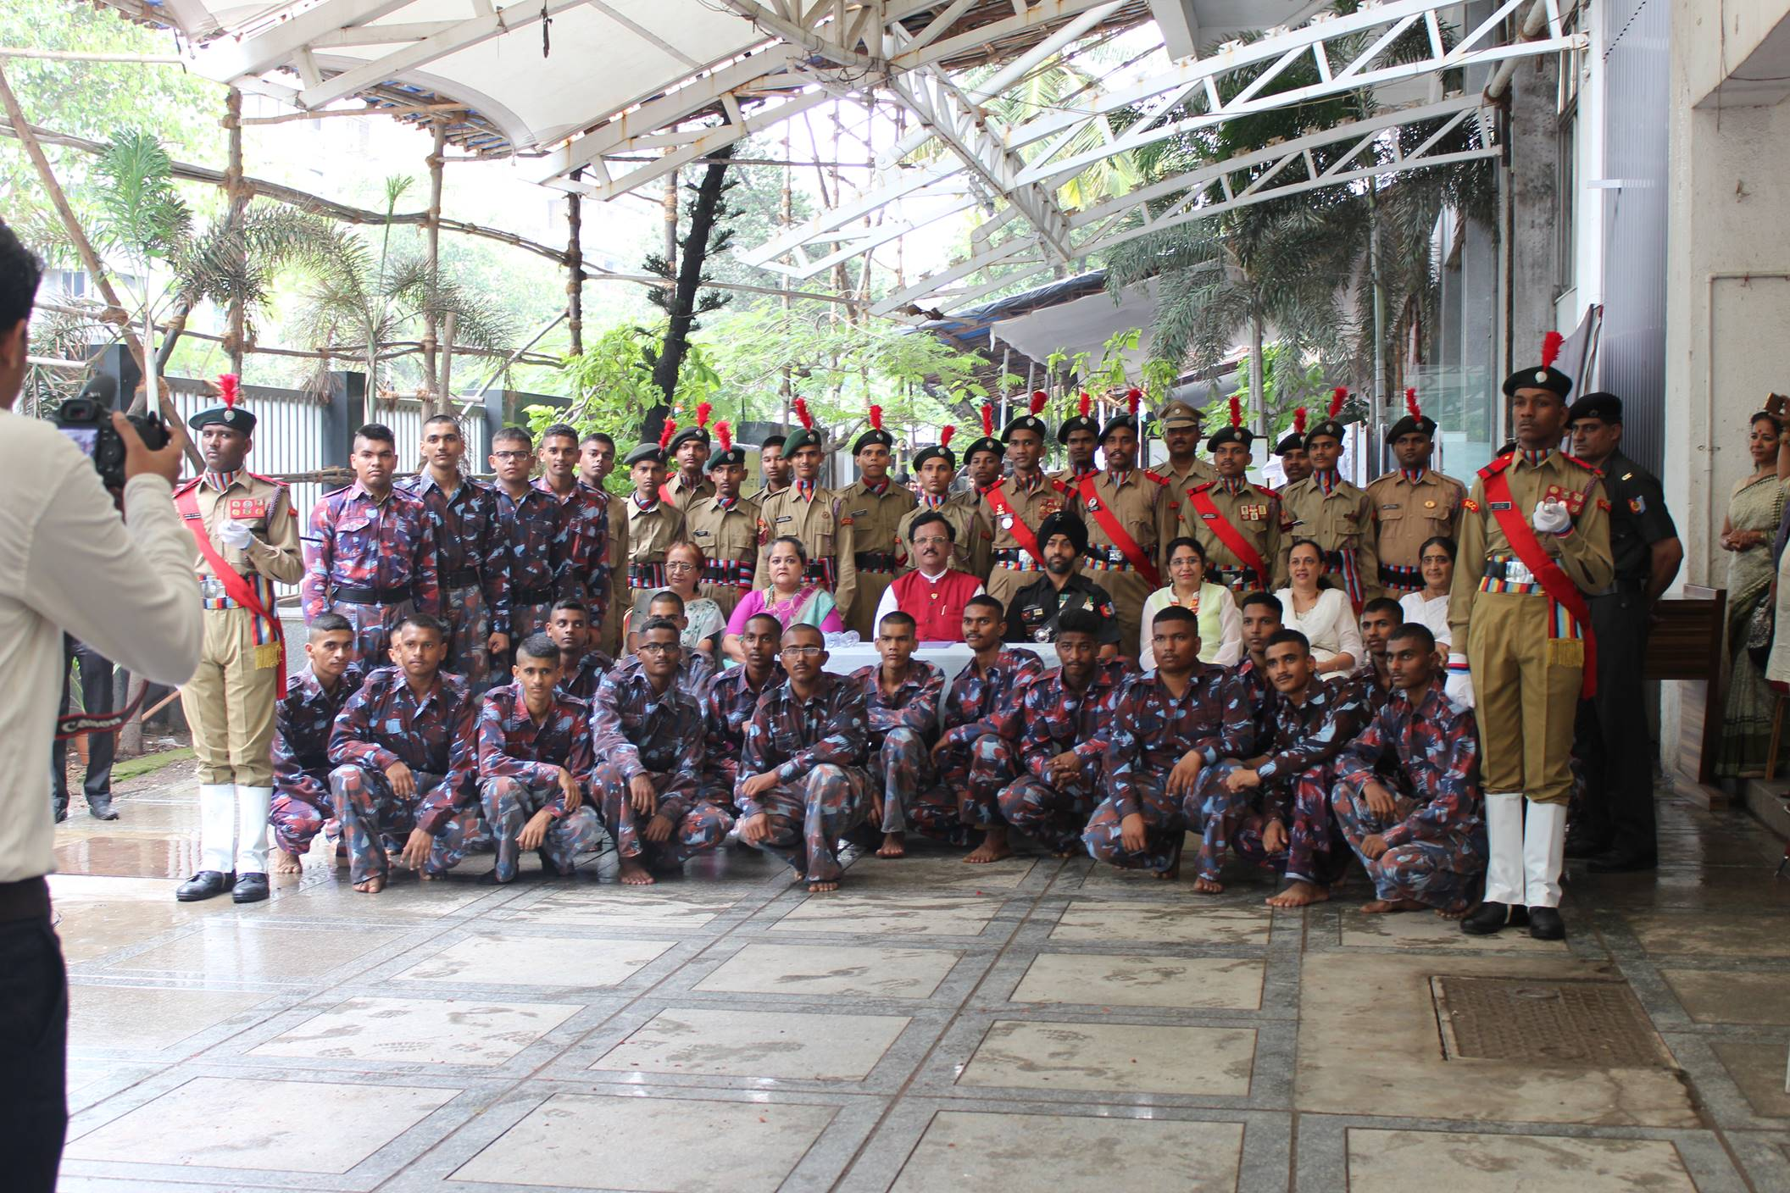

Slide 2
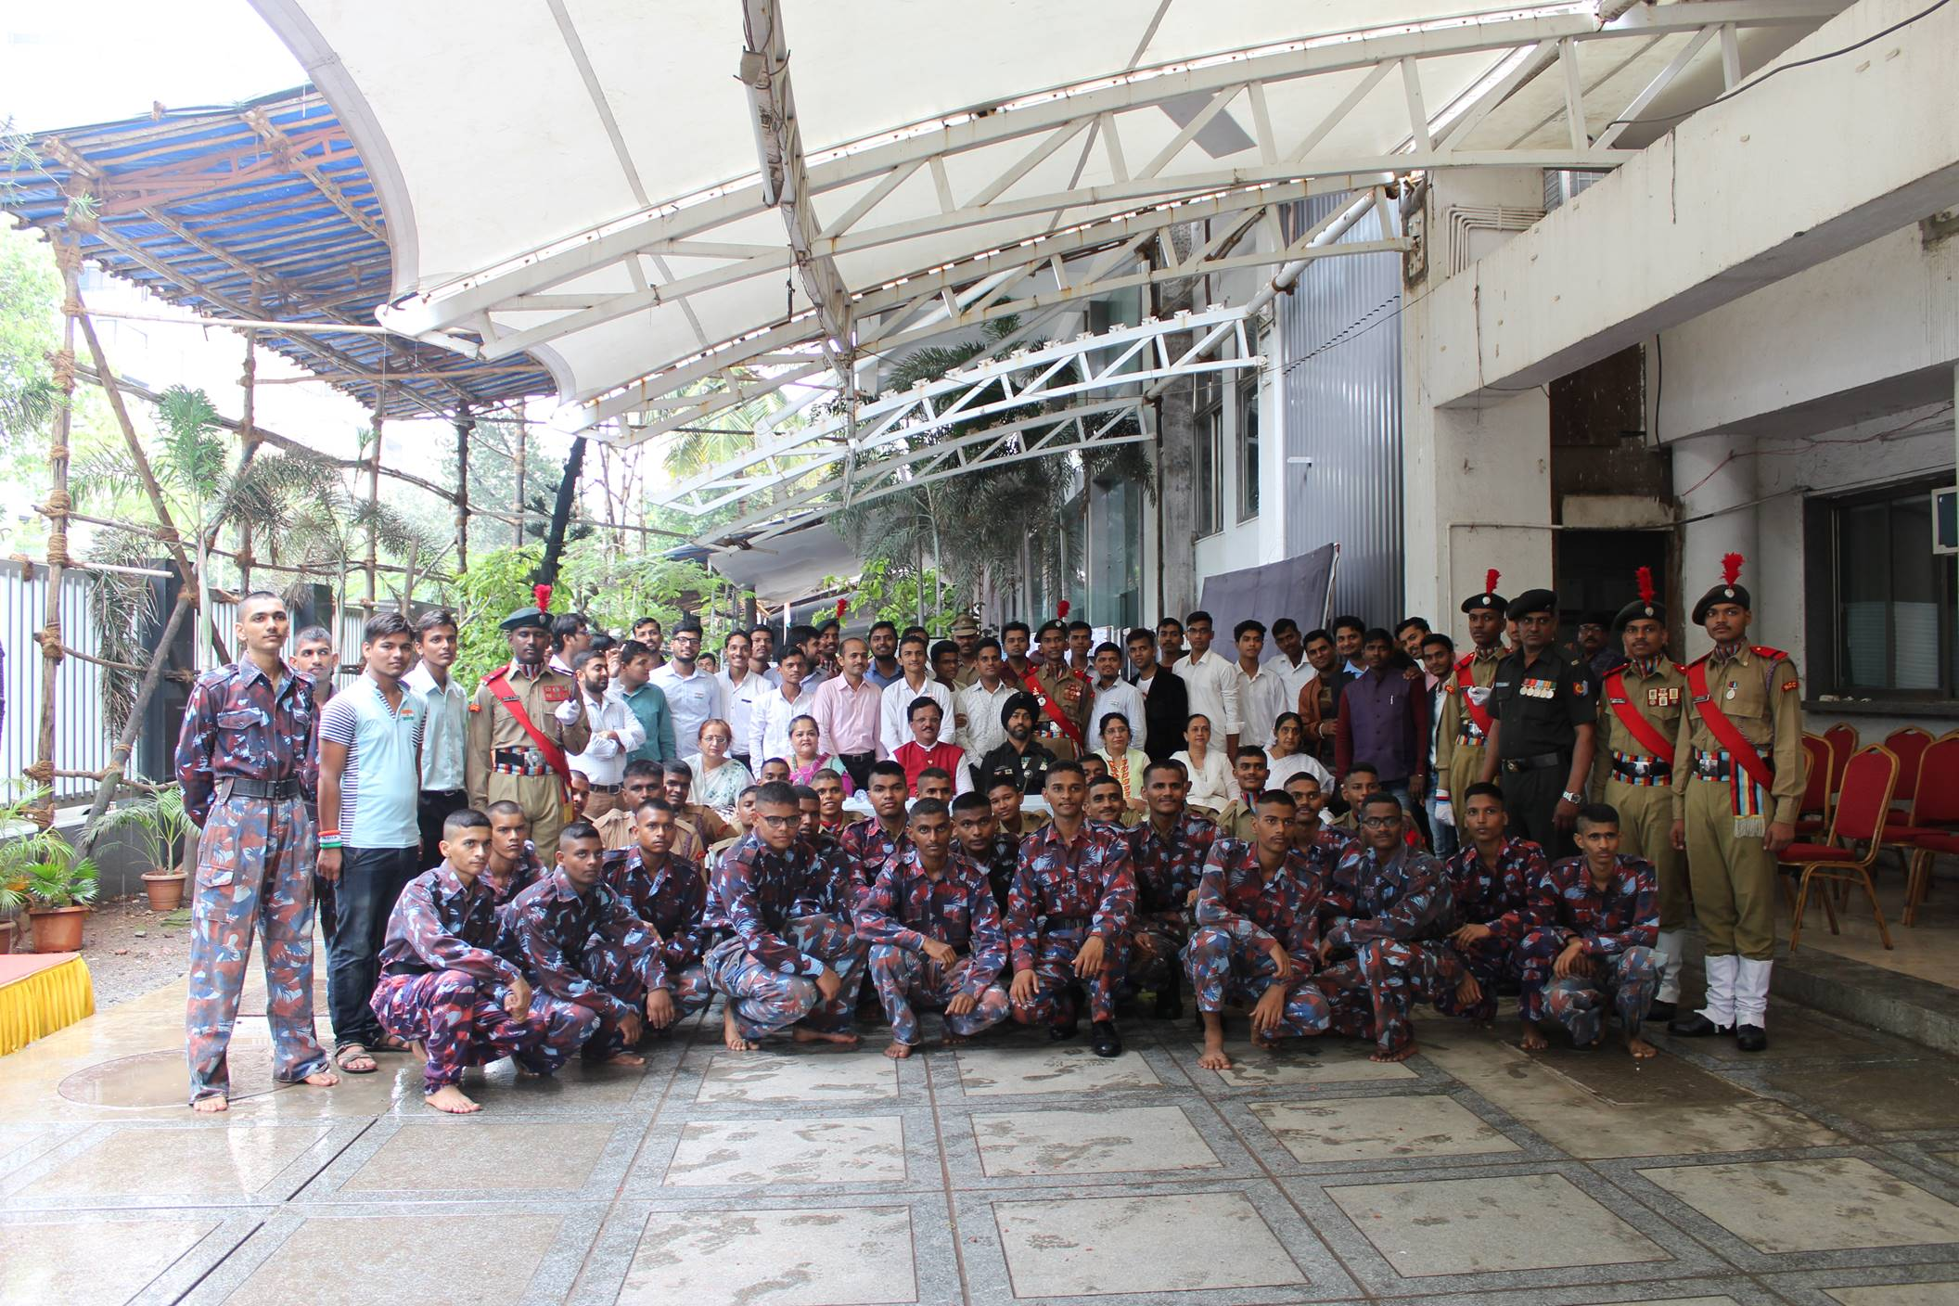

Slide 3
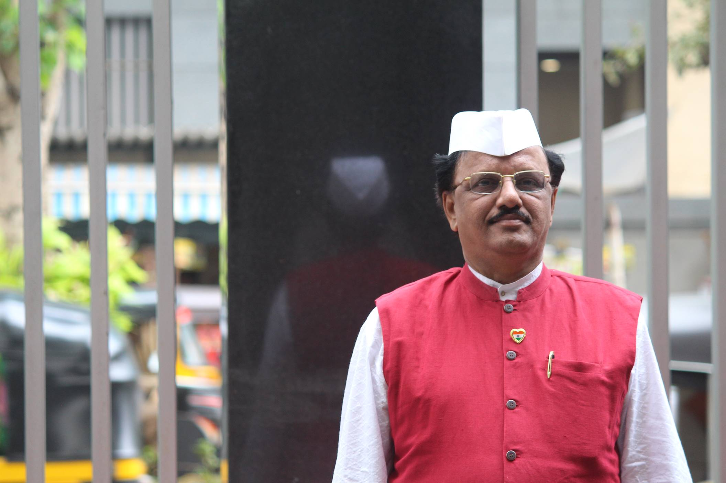

Slide 4
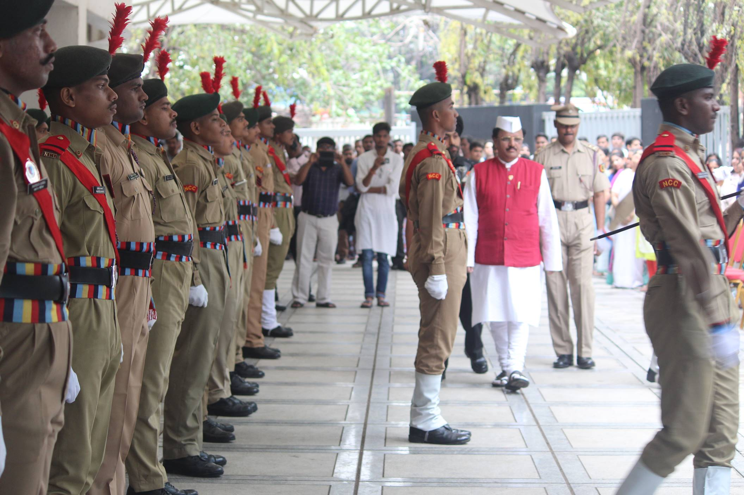

Slide 5
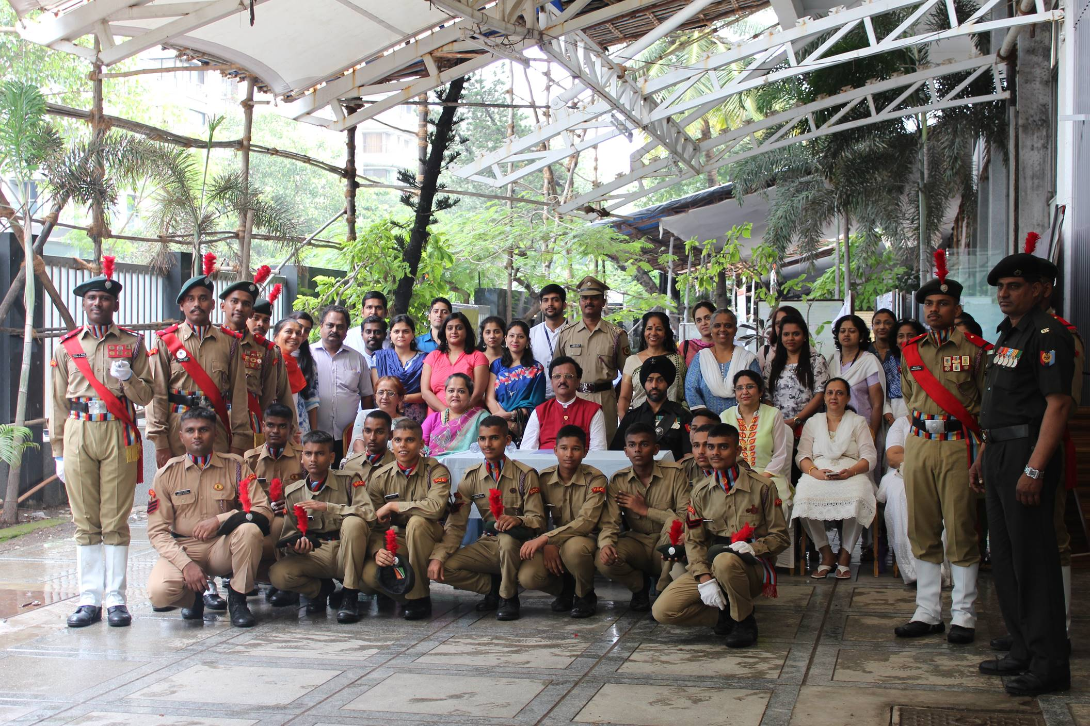

Slide 6
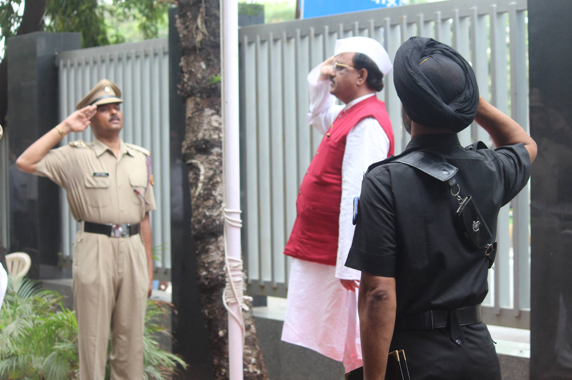

Slide 7
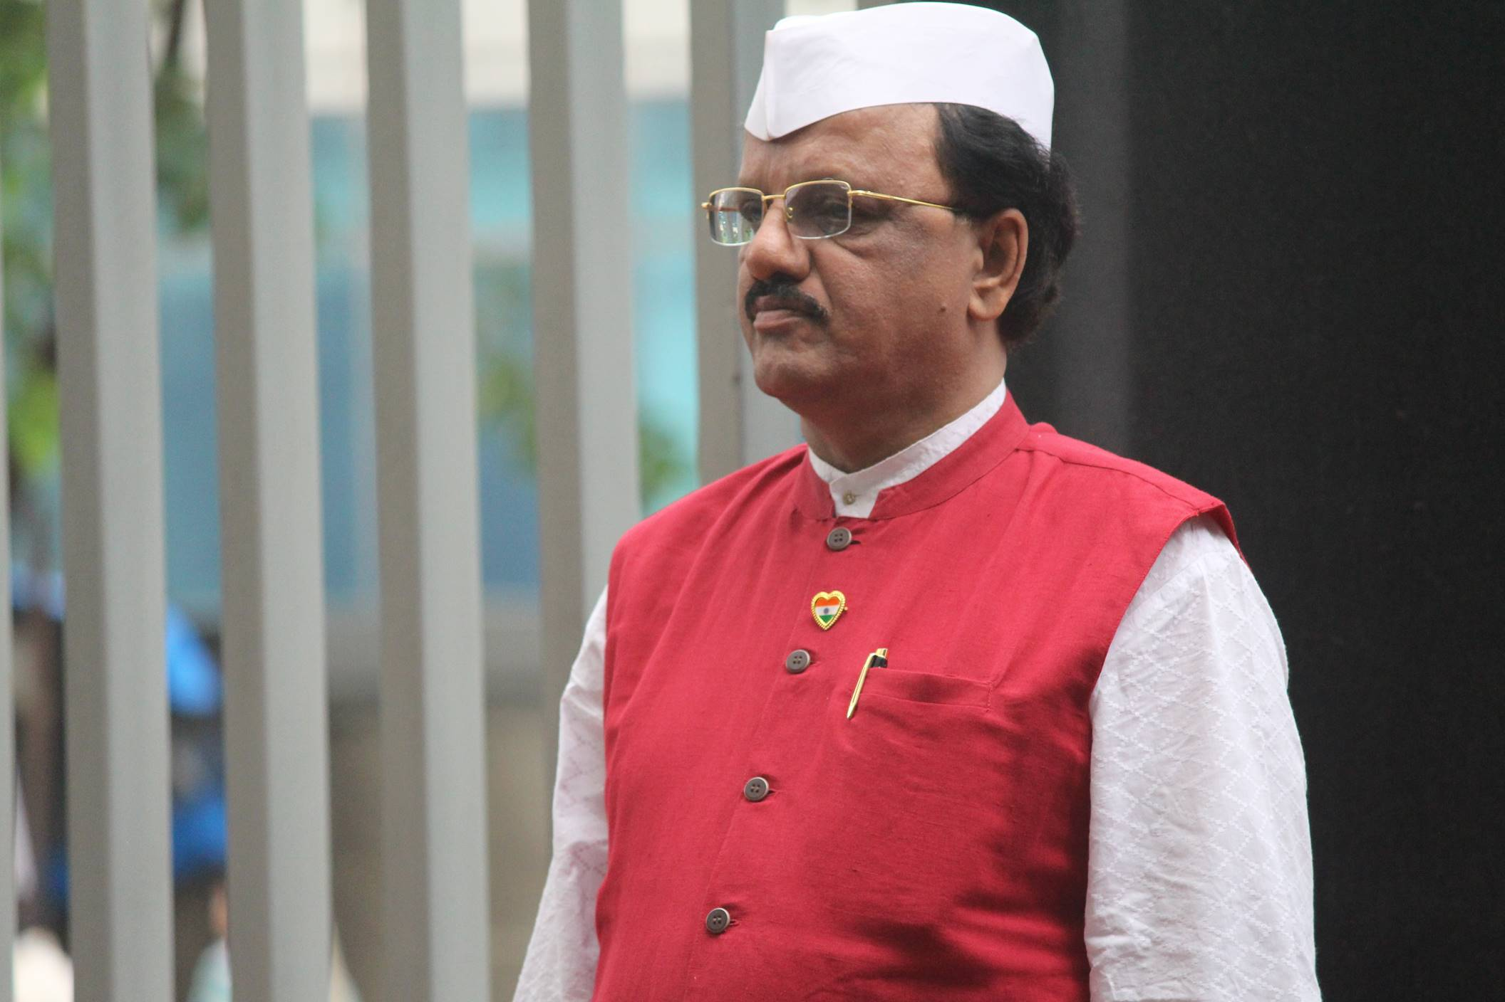

Slide 8
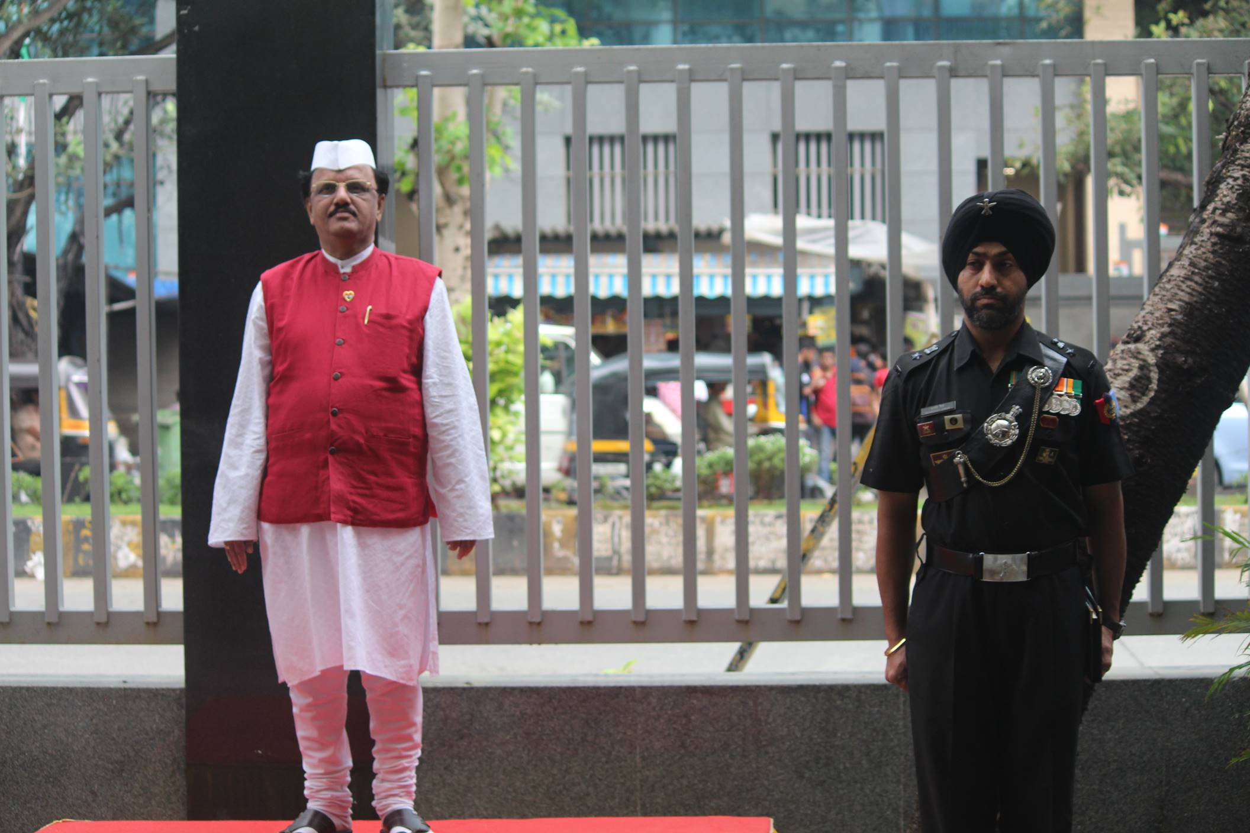

Slide 9
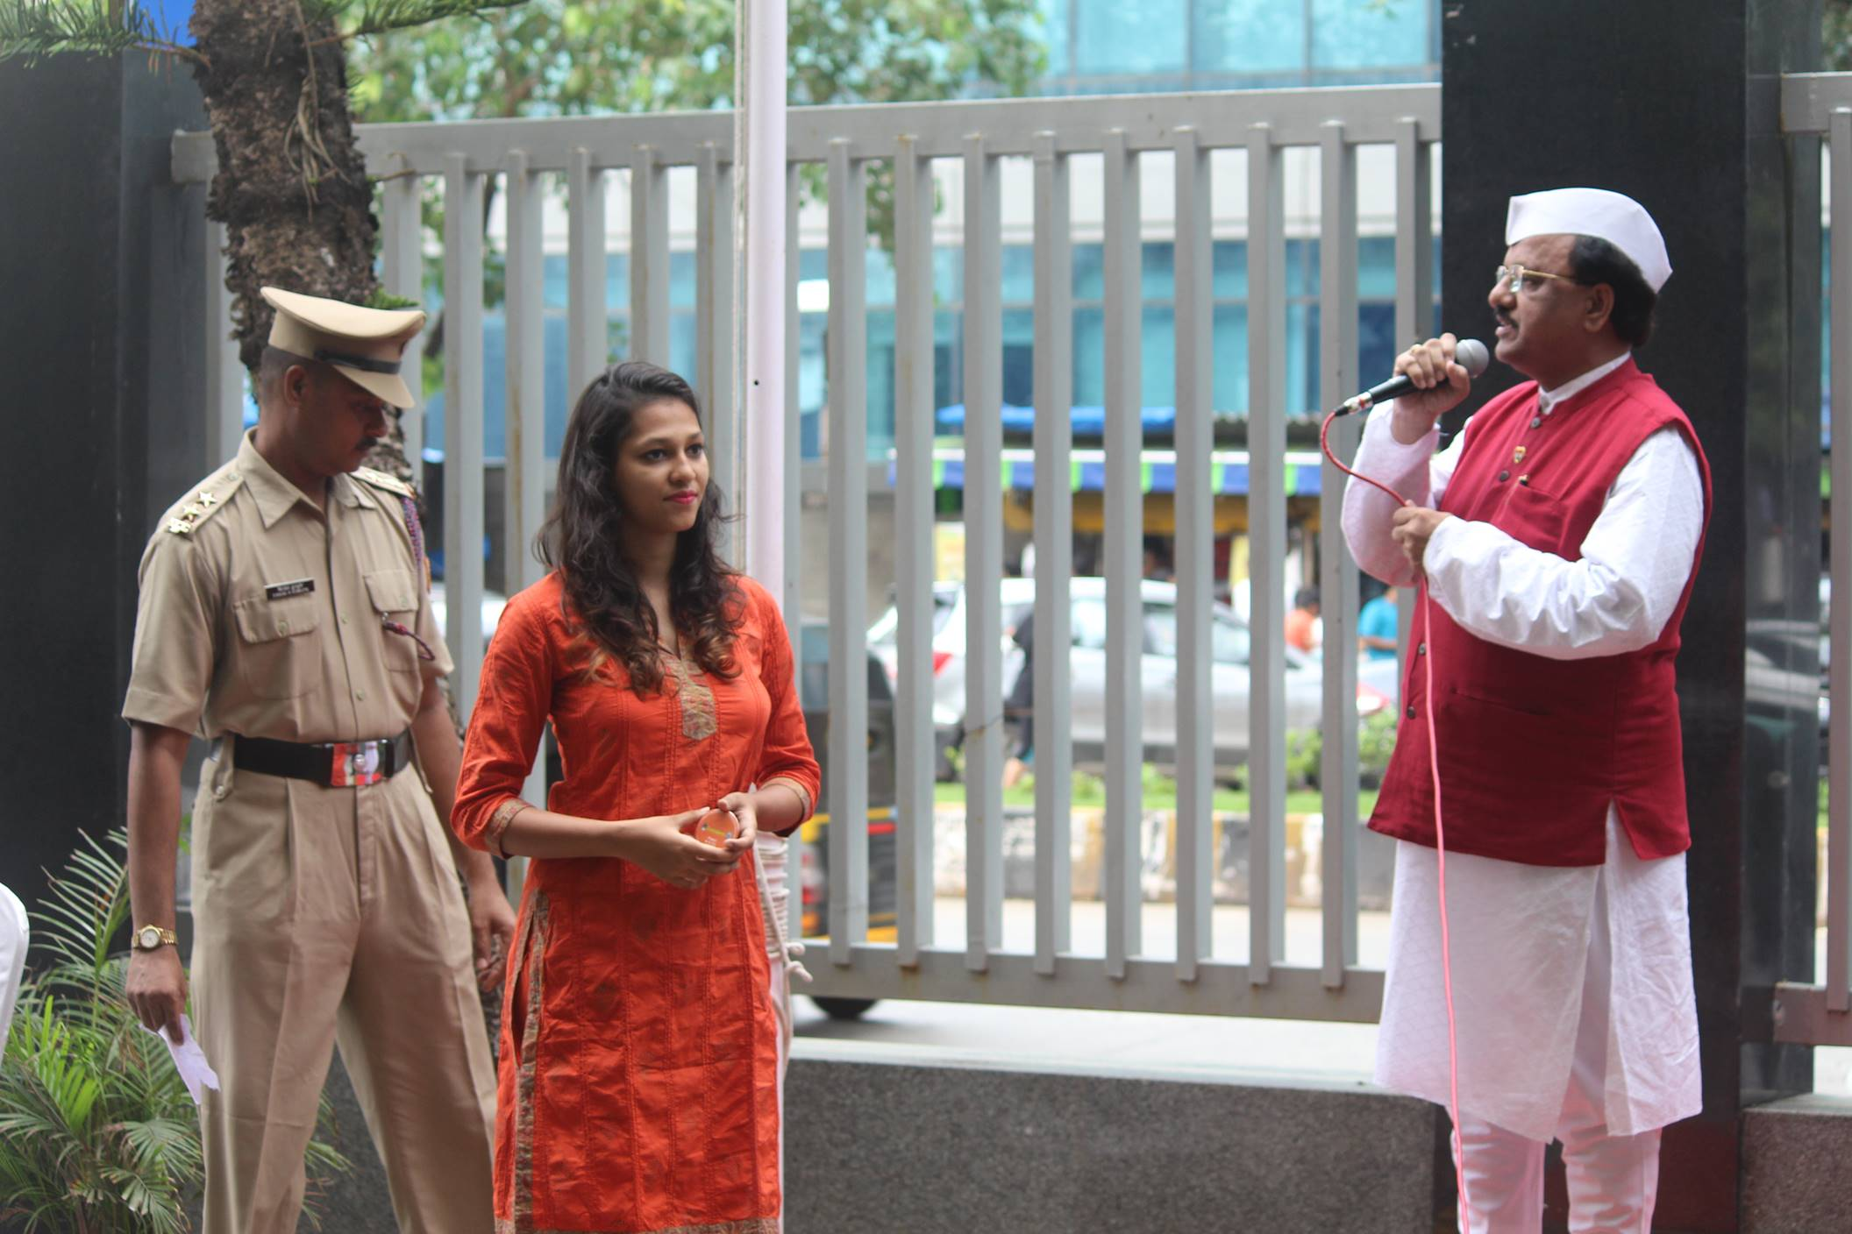

Slide 10
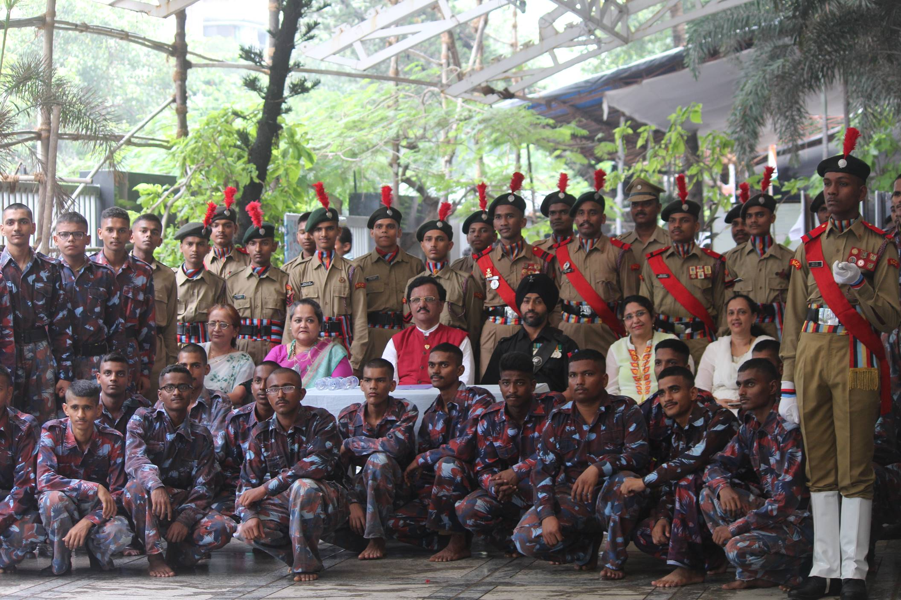

Slide 11
NOTICE
Teachers and Student Volunteers of all events/festivals are hereby informed to refrain from displaying any promotional activity on any wall/granite pillar in the college campus.
The activity would stand cancelled in non-compliance of the above instruction.
Principal

Slide 12
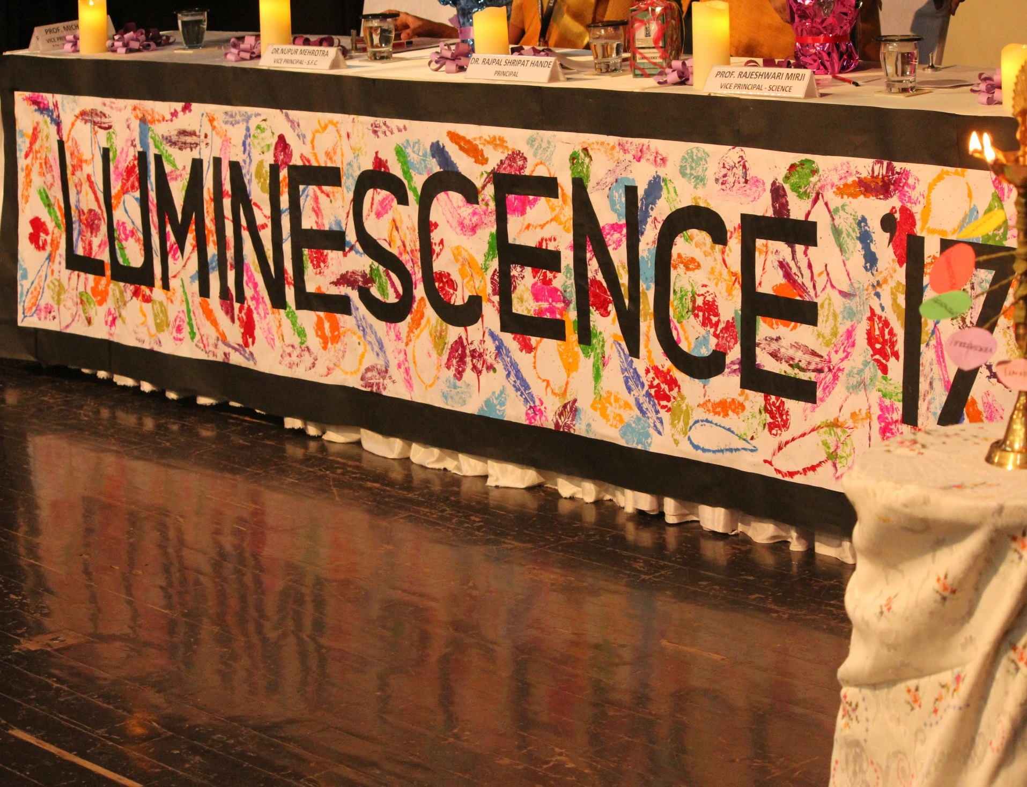

Slide 13
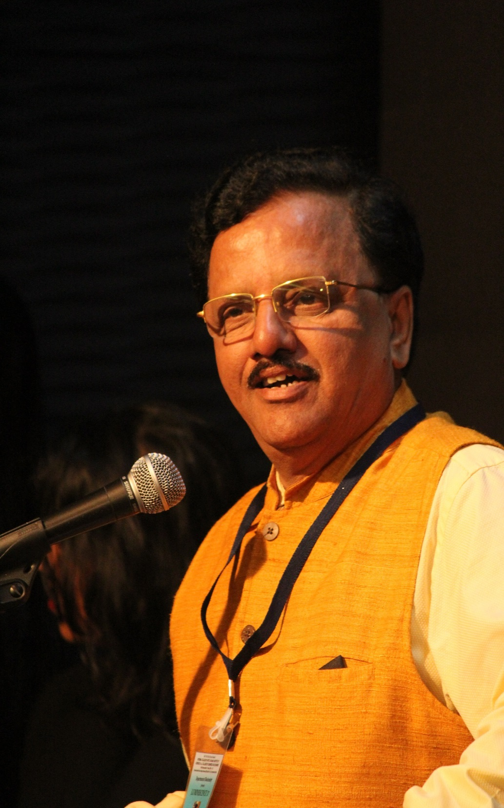
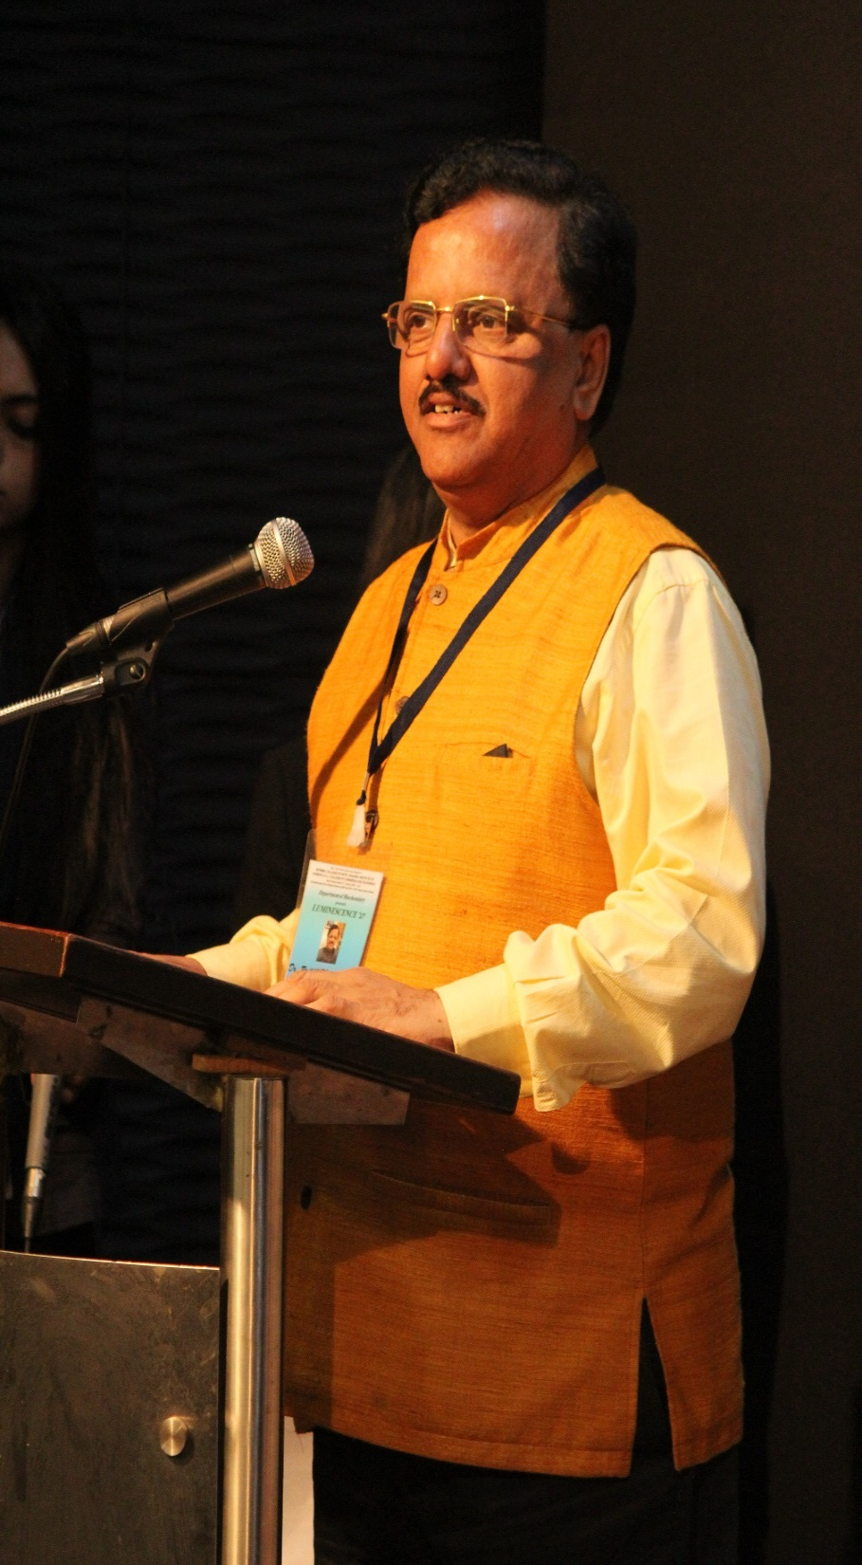
Principal Dr Rajpal Shripat Hande at the Inauguration of Luminescence 2017

Slide 14
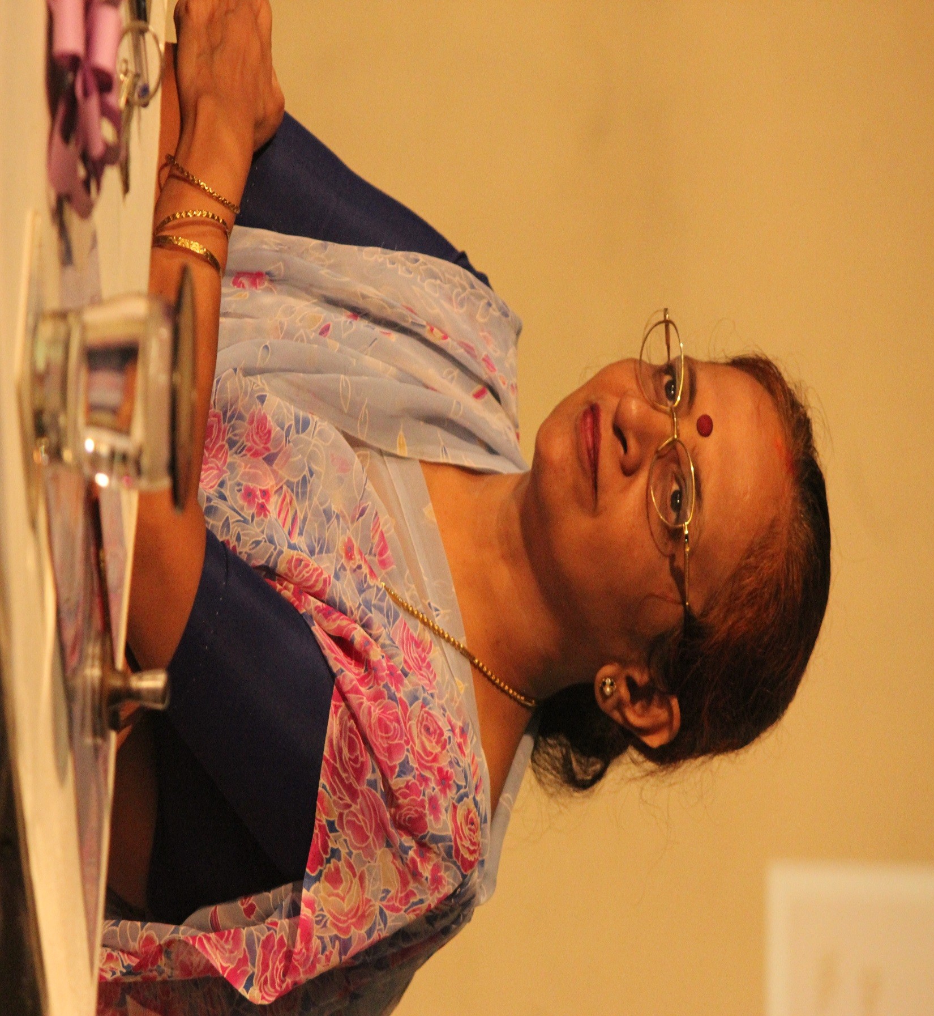
Vice Principal Science Prof. Mirji at the Inauguration of Luminescence 2017

Slide 15
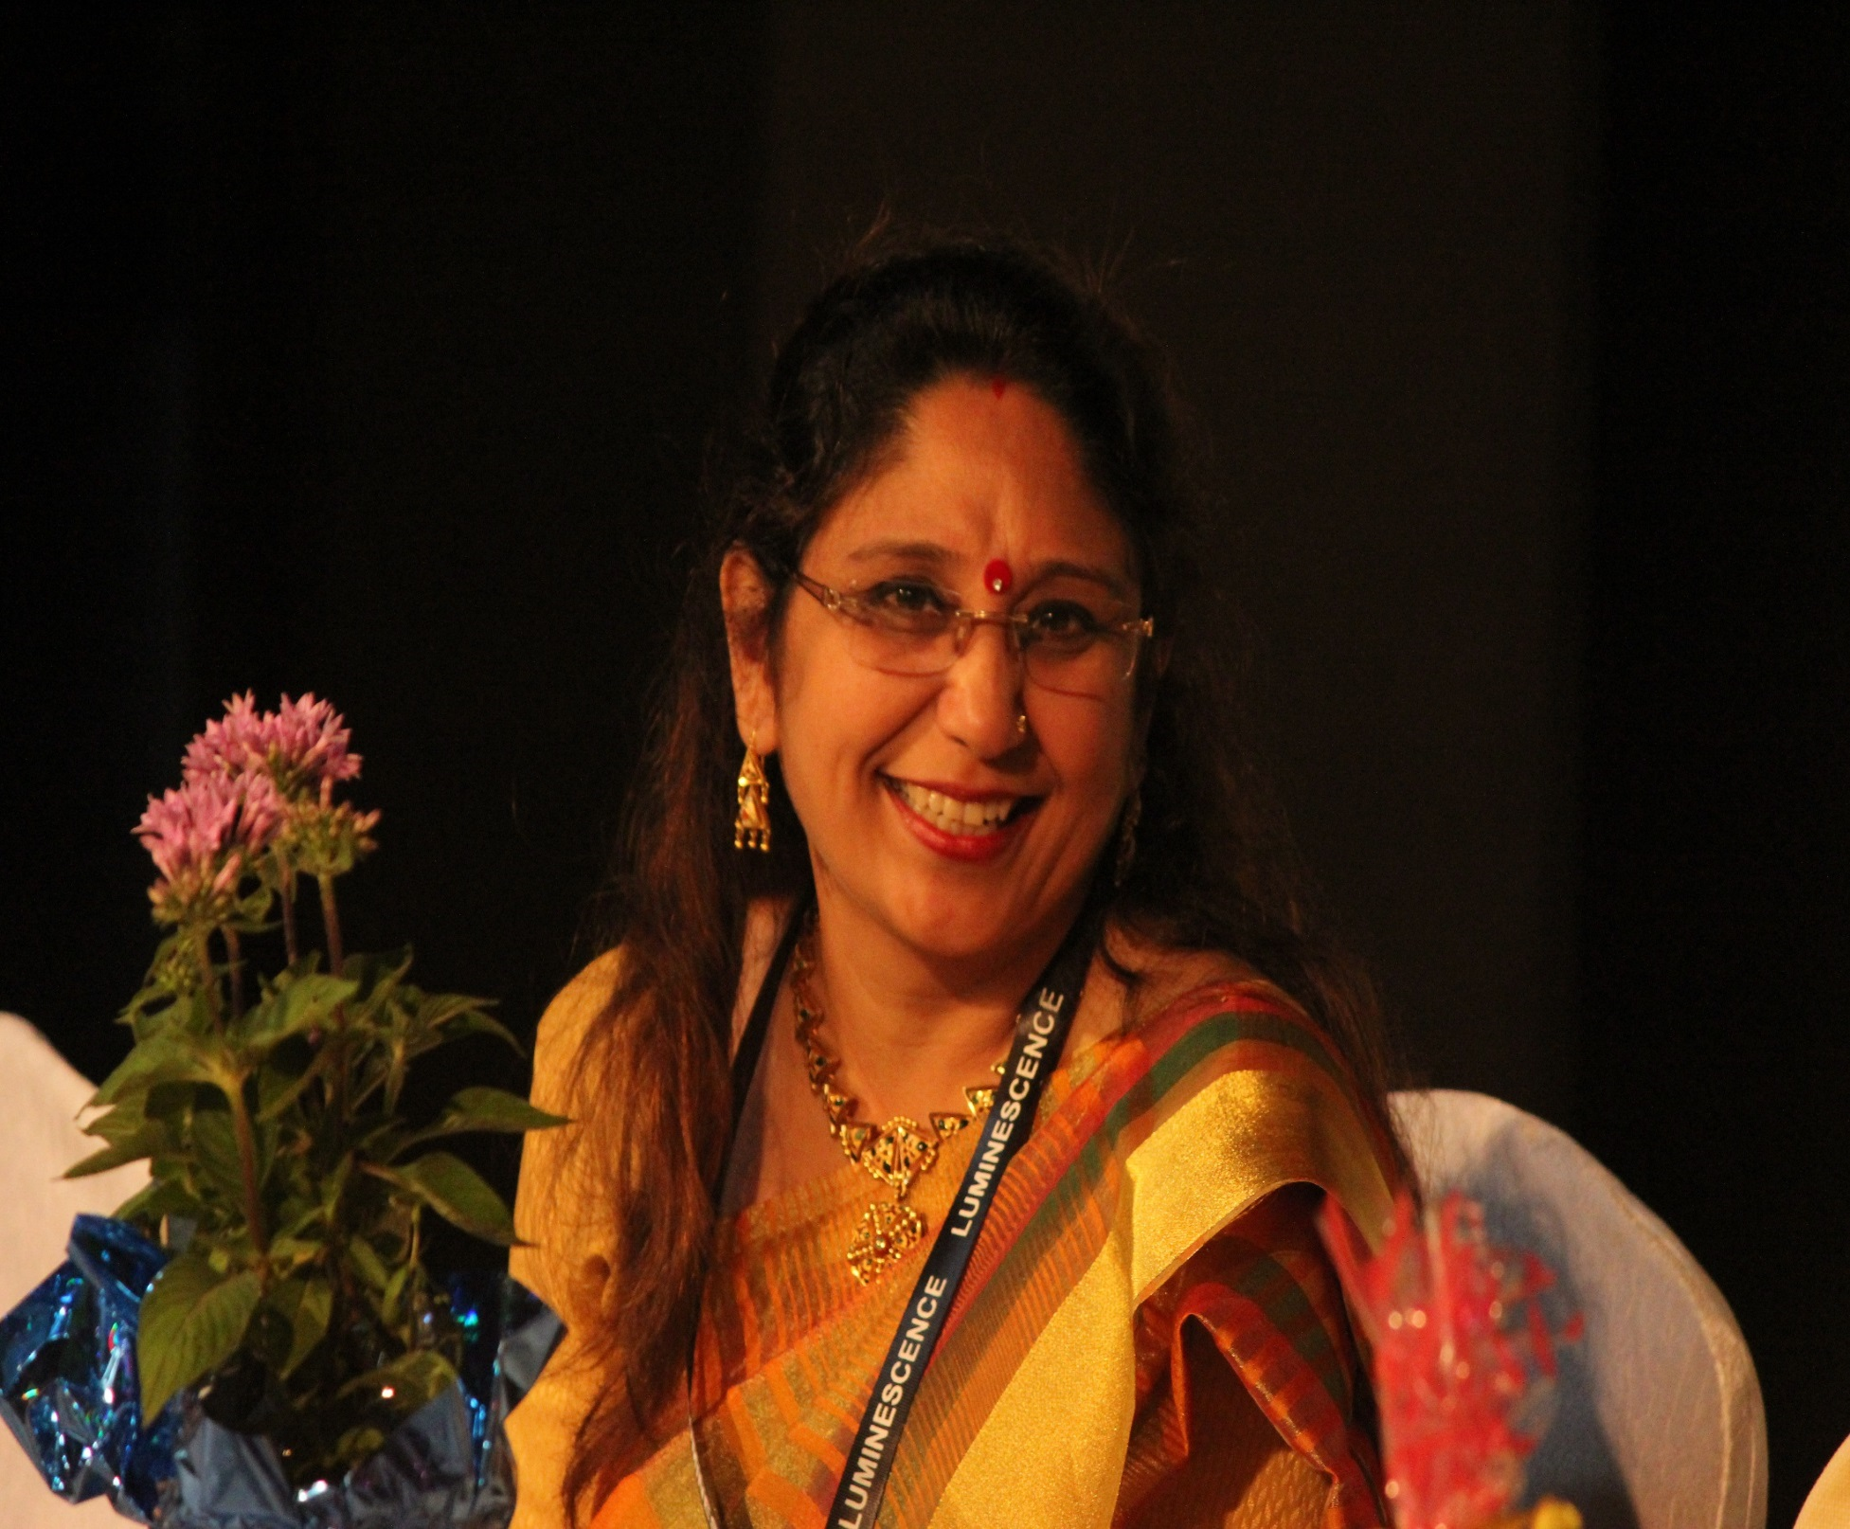
Vice Principal Self Finance Courses Dr Nupur Mehrotra at the Inauguration of Luminescence 2017

Slide 16
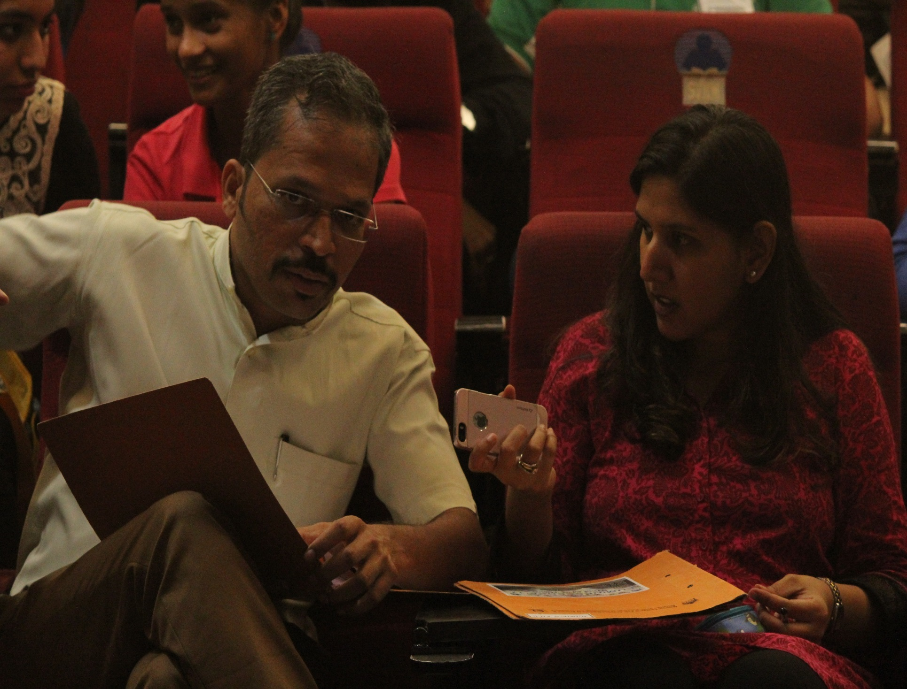
Mr Nainesh Koli & Ms Amruta Philip Judges of Debate Competition (Loud and Clear) at Luminescence 2017

Slide 17
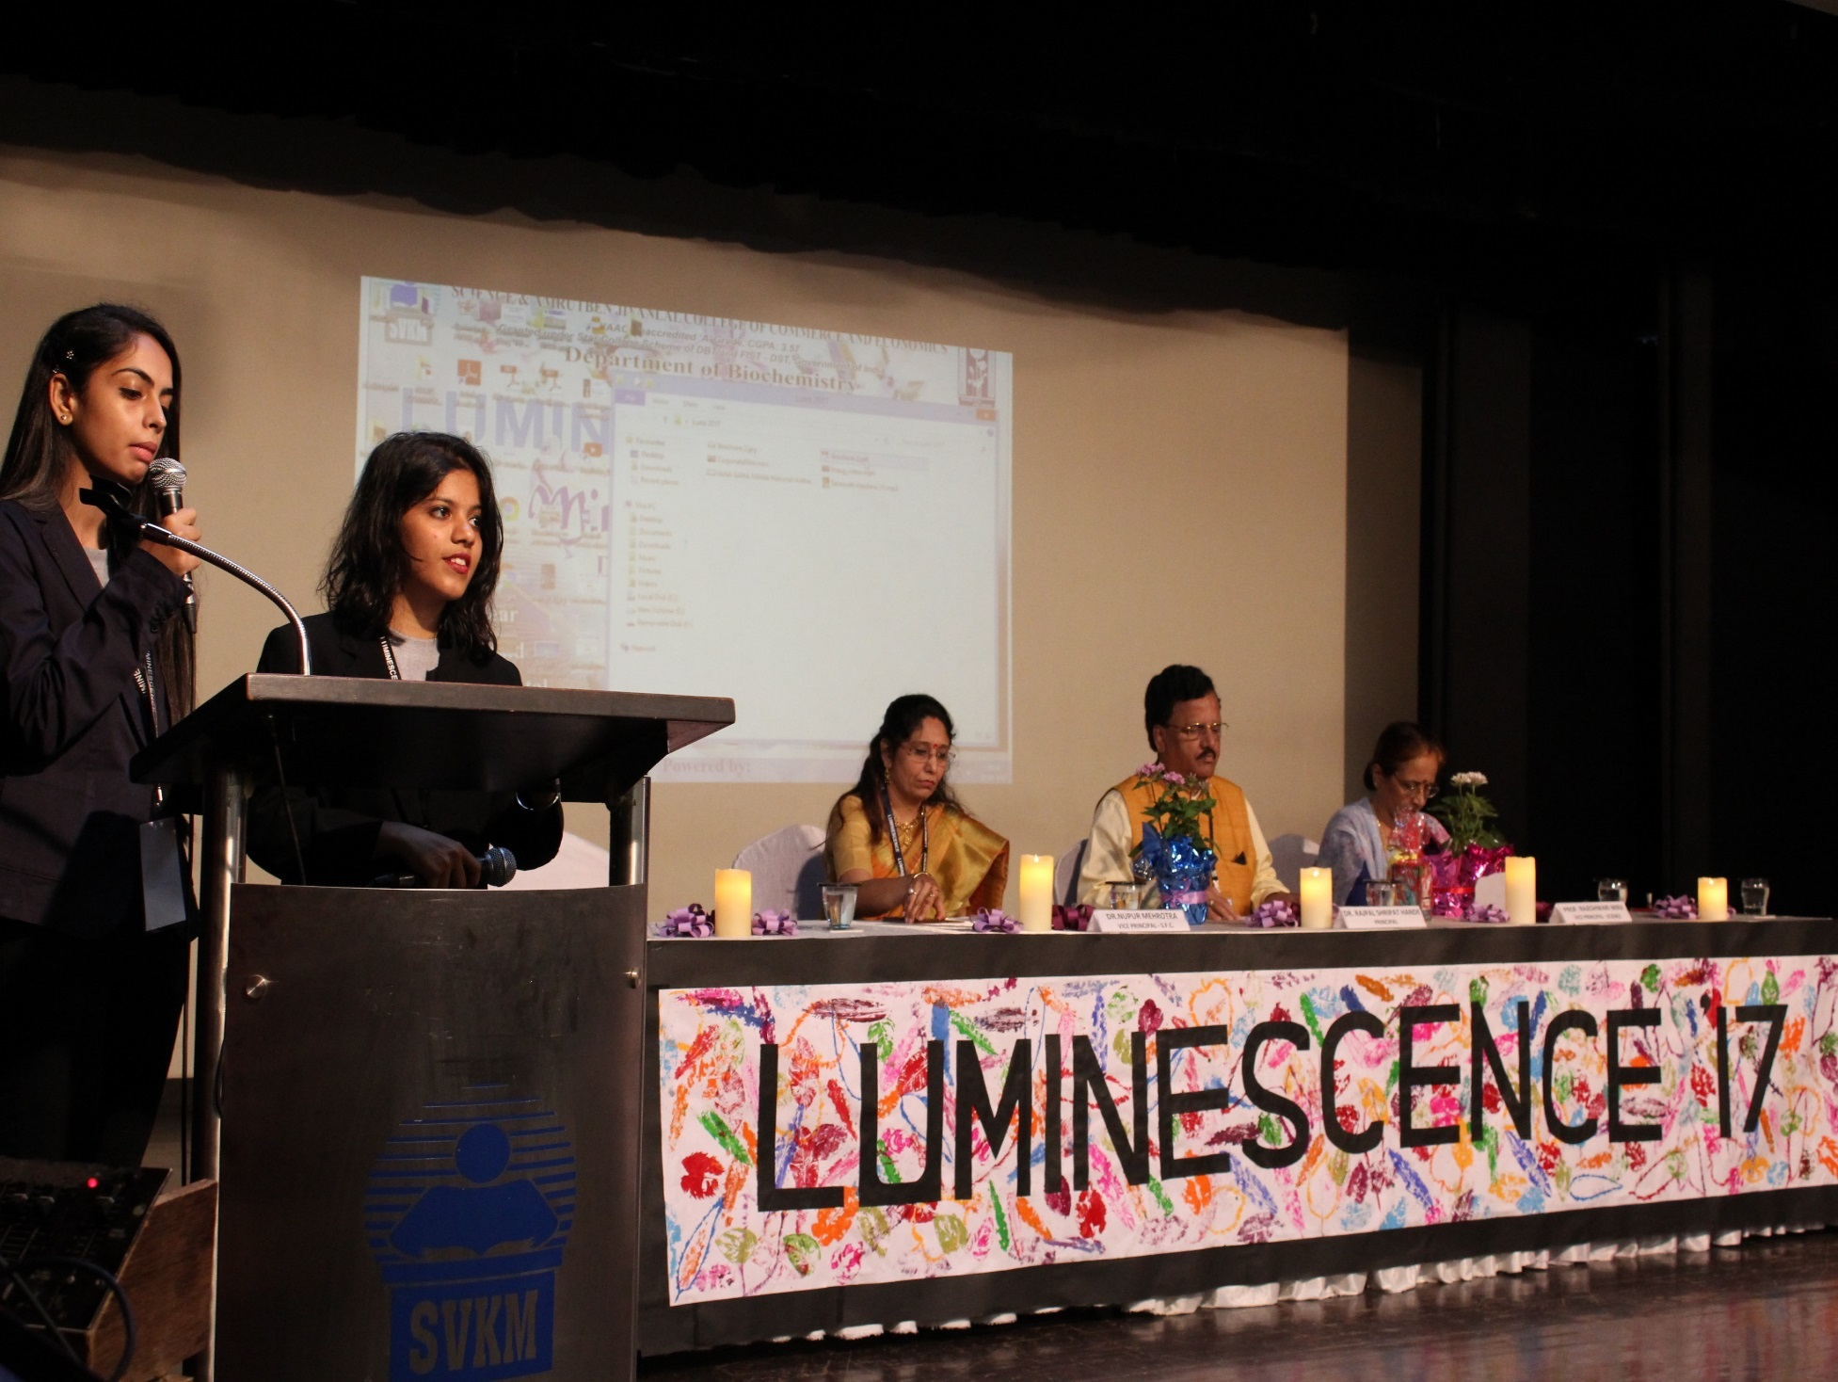

Slide 18
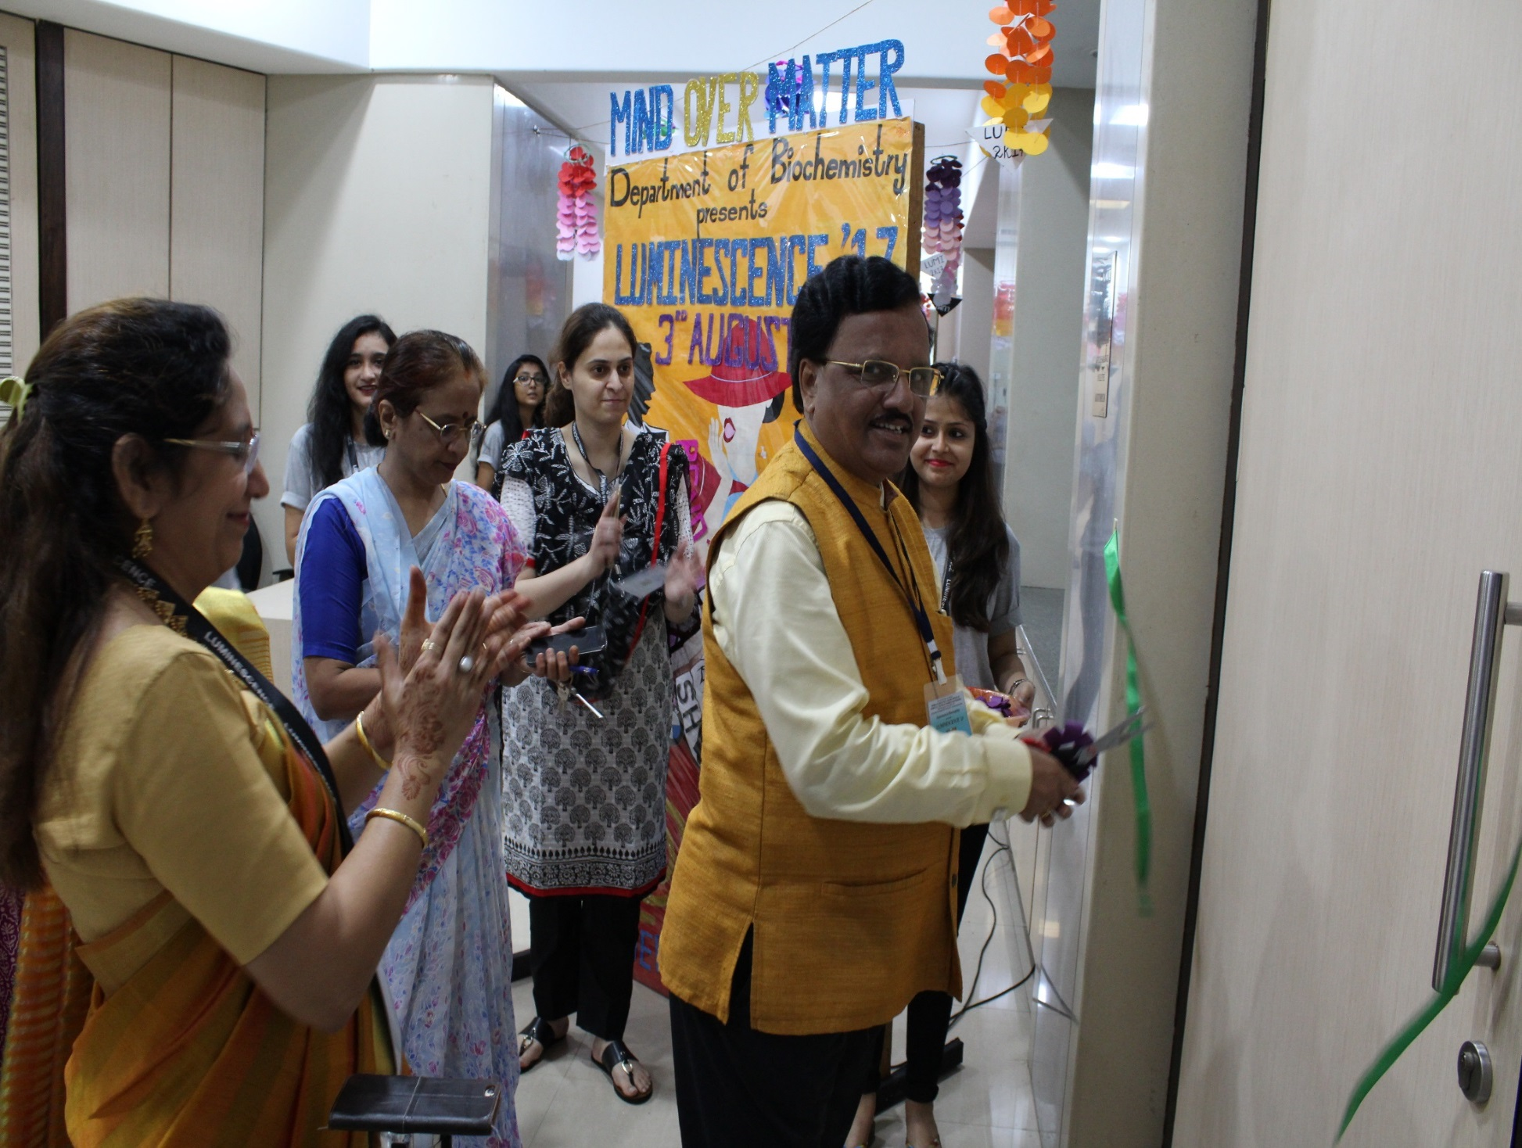
Principal Dr Rajpal Shripat Hande at the Inauguration of Luminescence 2017

Slide 19
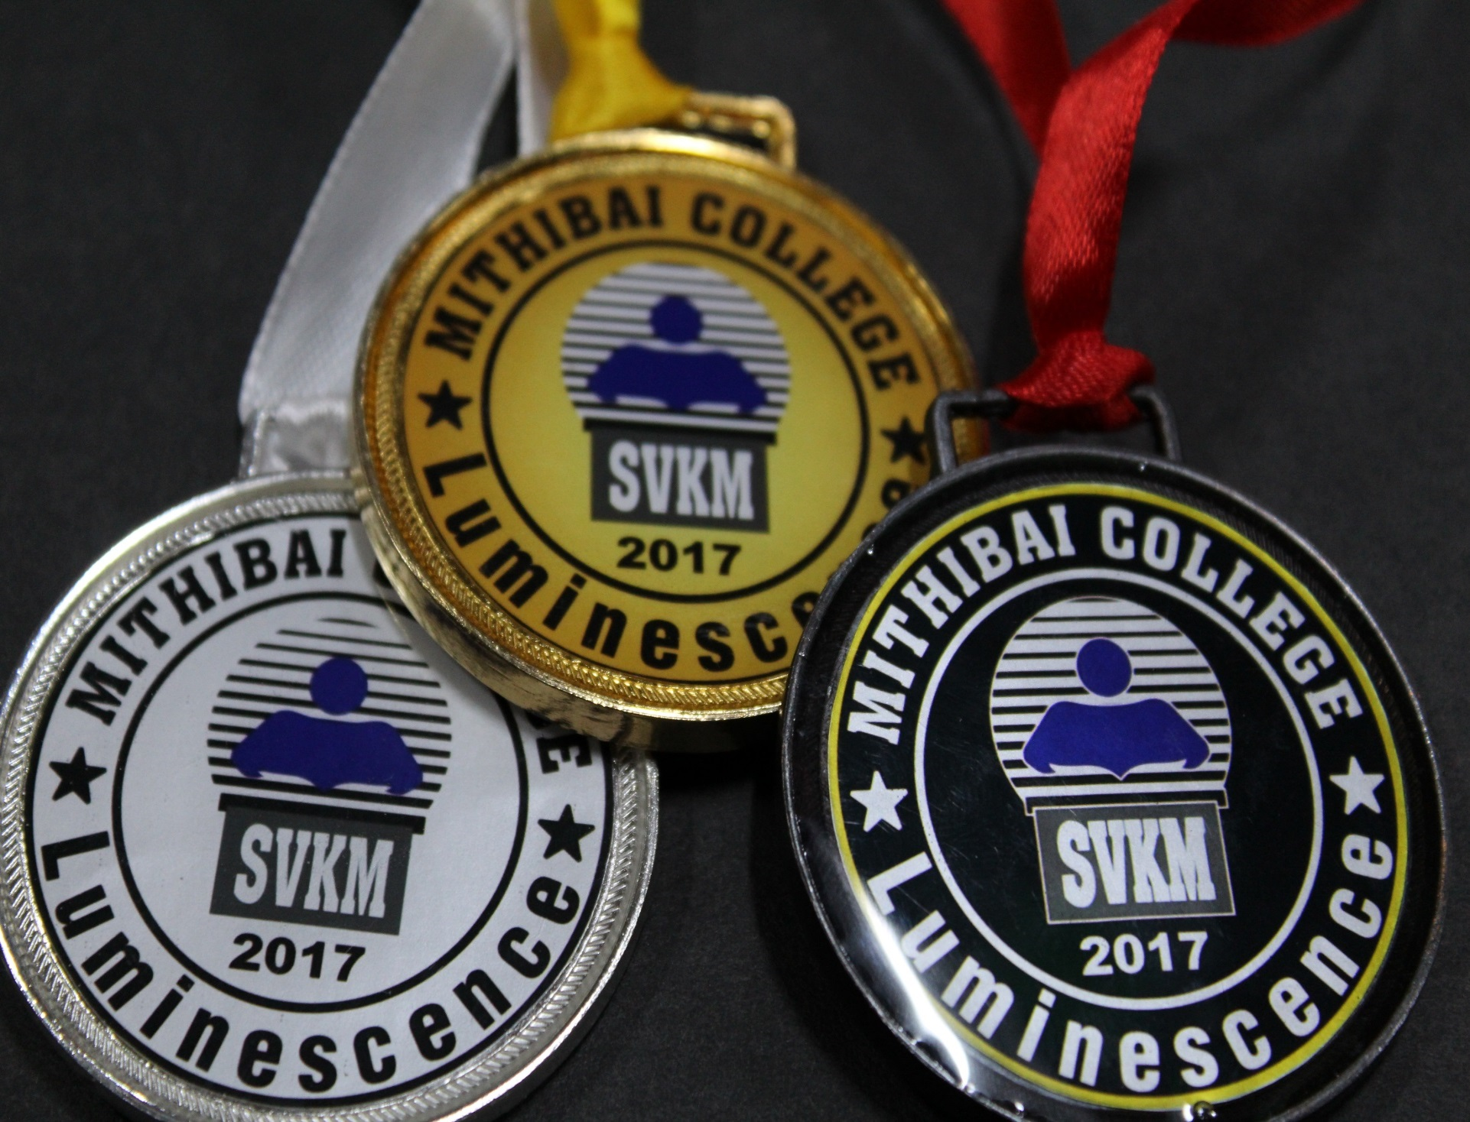

Slide 20
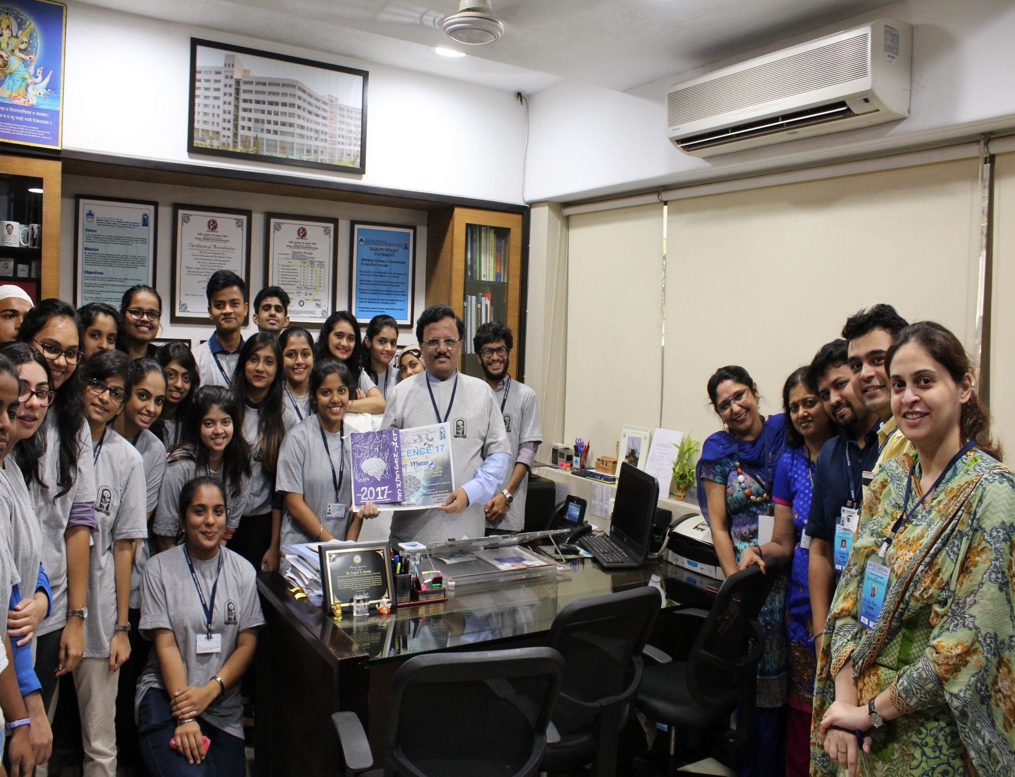
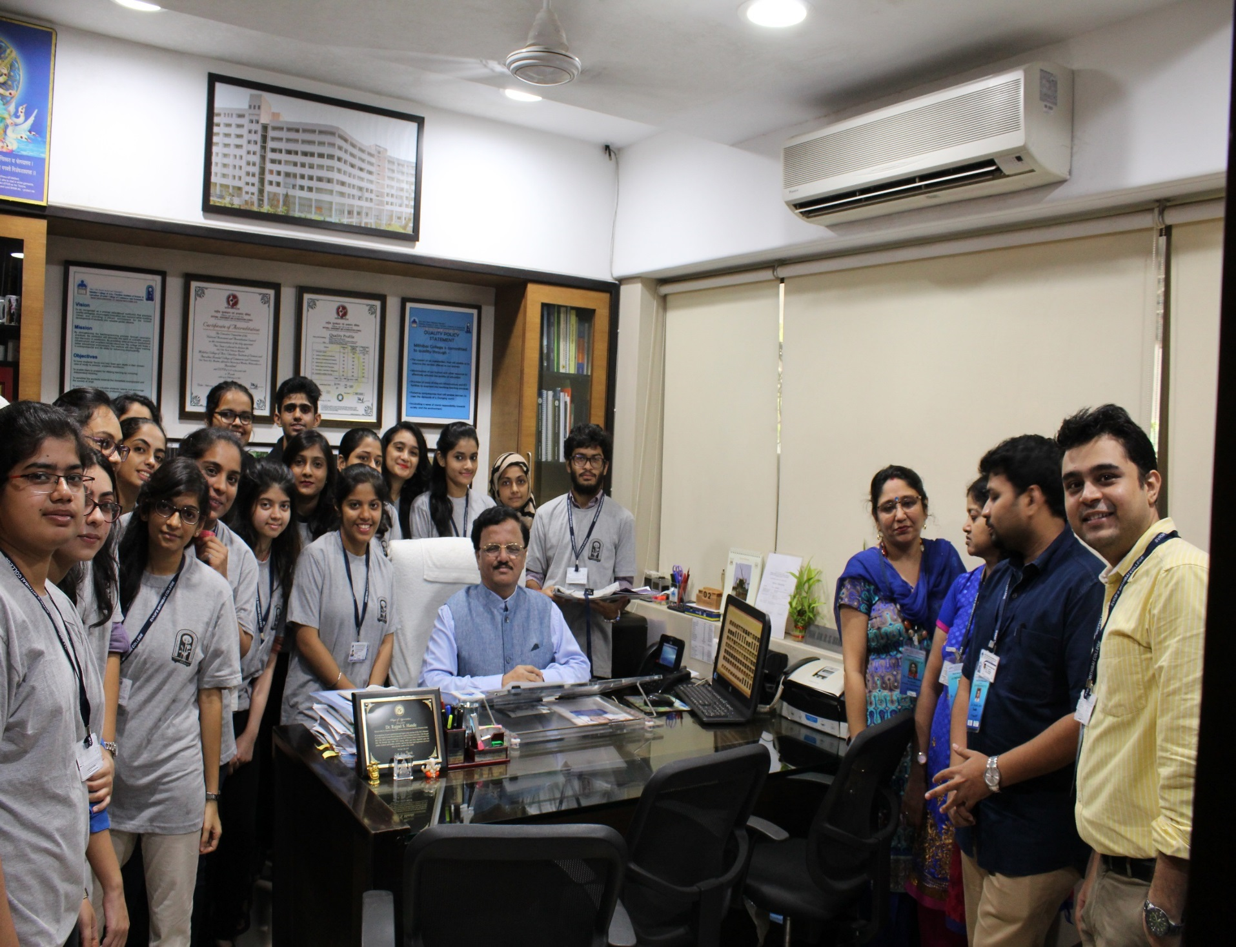
Team Luminescence with Principal Dr Rajpal Shripat Hande

Slide 21
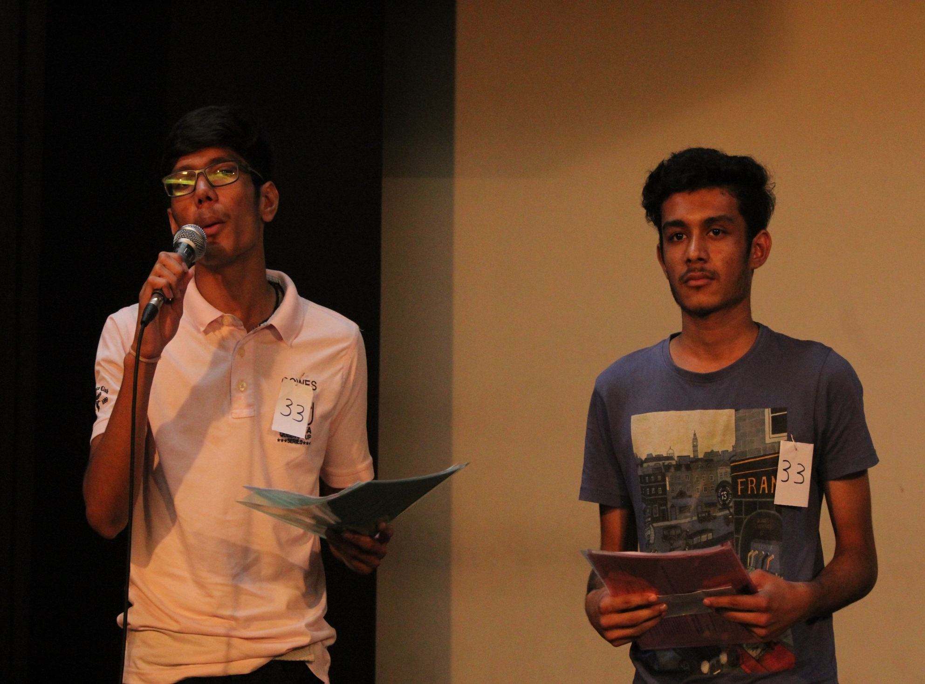
Debate at Luminescence 2017

Slide 22
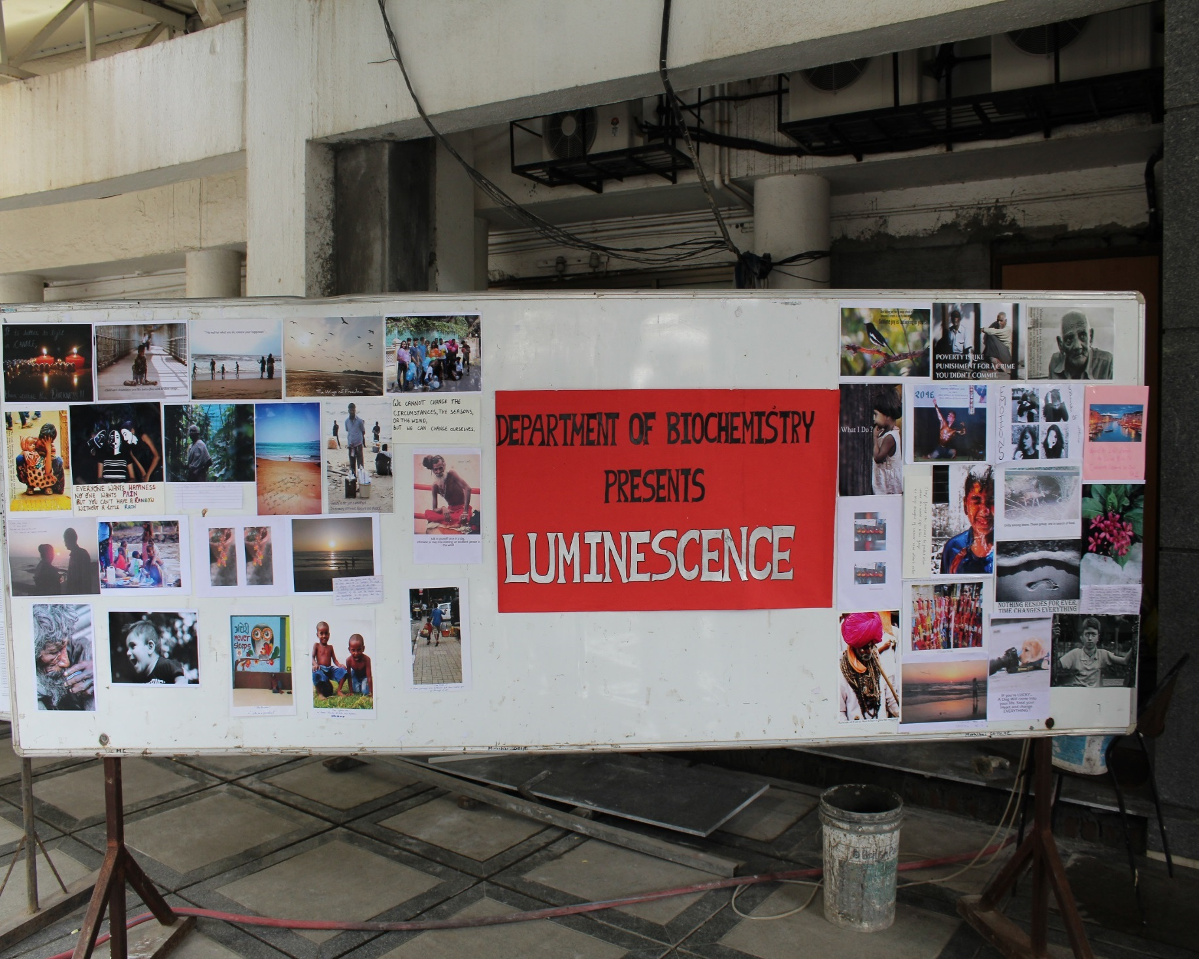
Shutters Up at Luminescence 2017

Slide 23
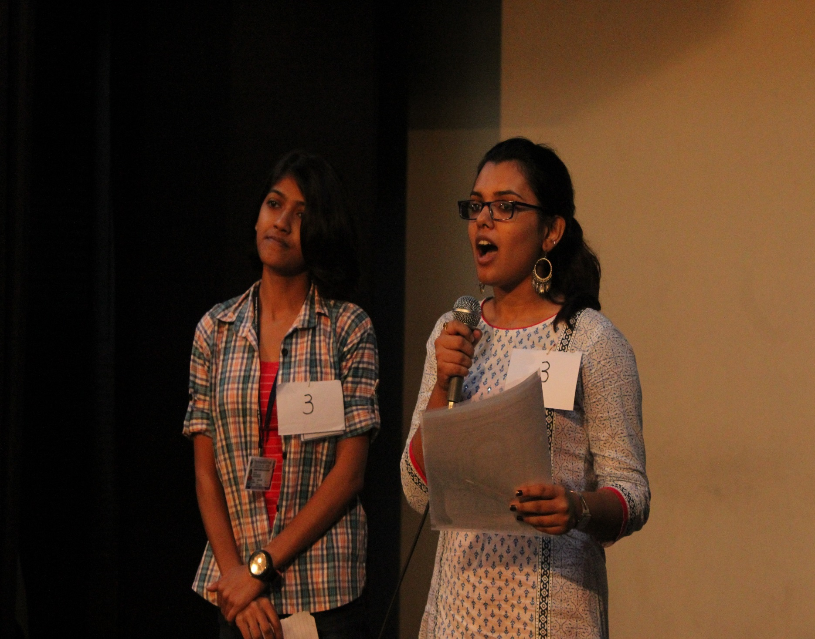
Debate at Luminescence 2017

Slide 24
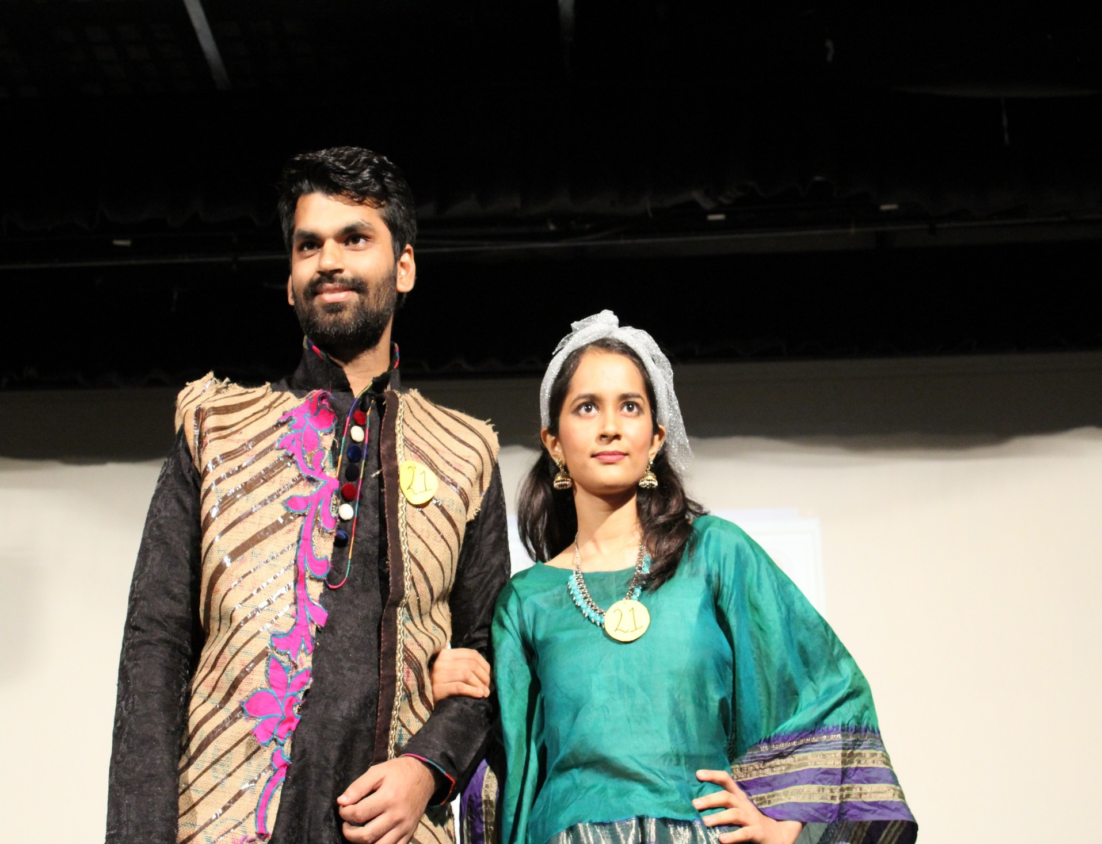
Fashion Show (Bend the Trend) at Luminescence 2017

Slide 25
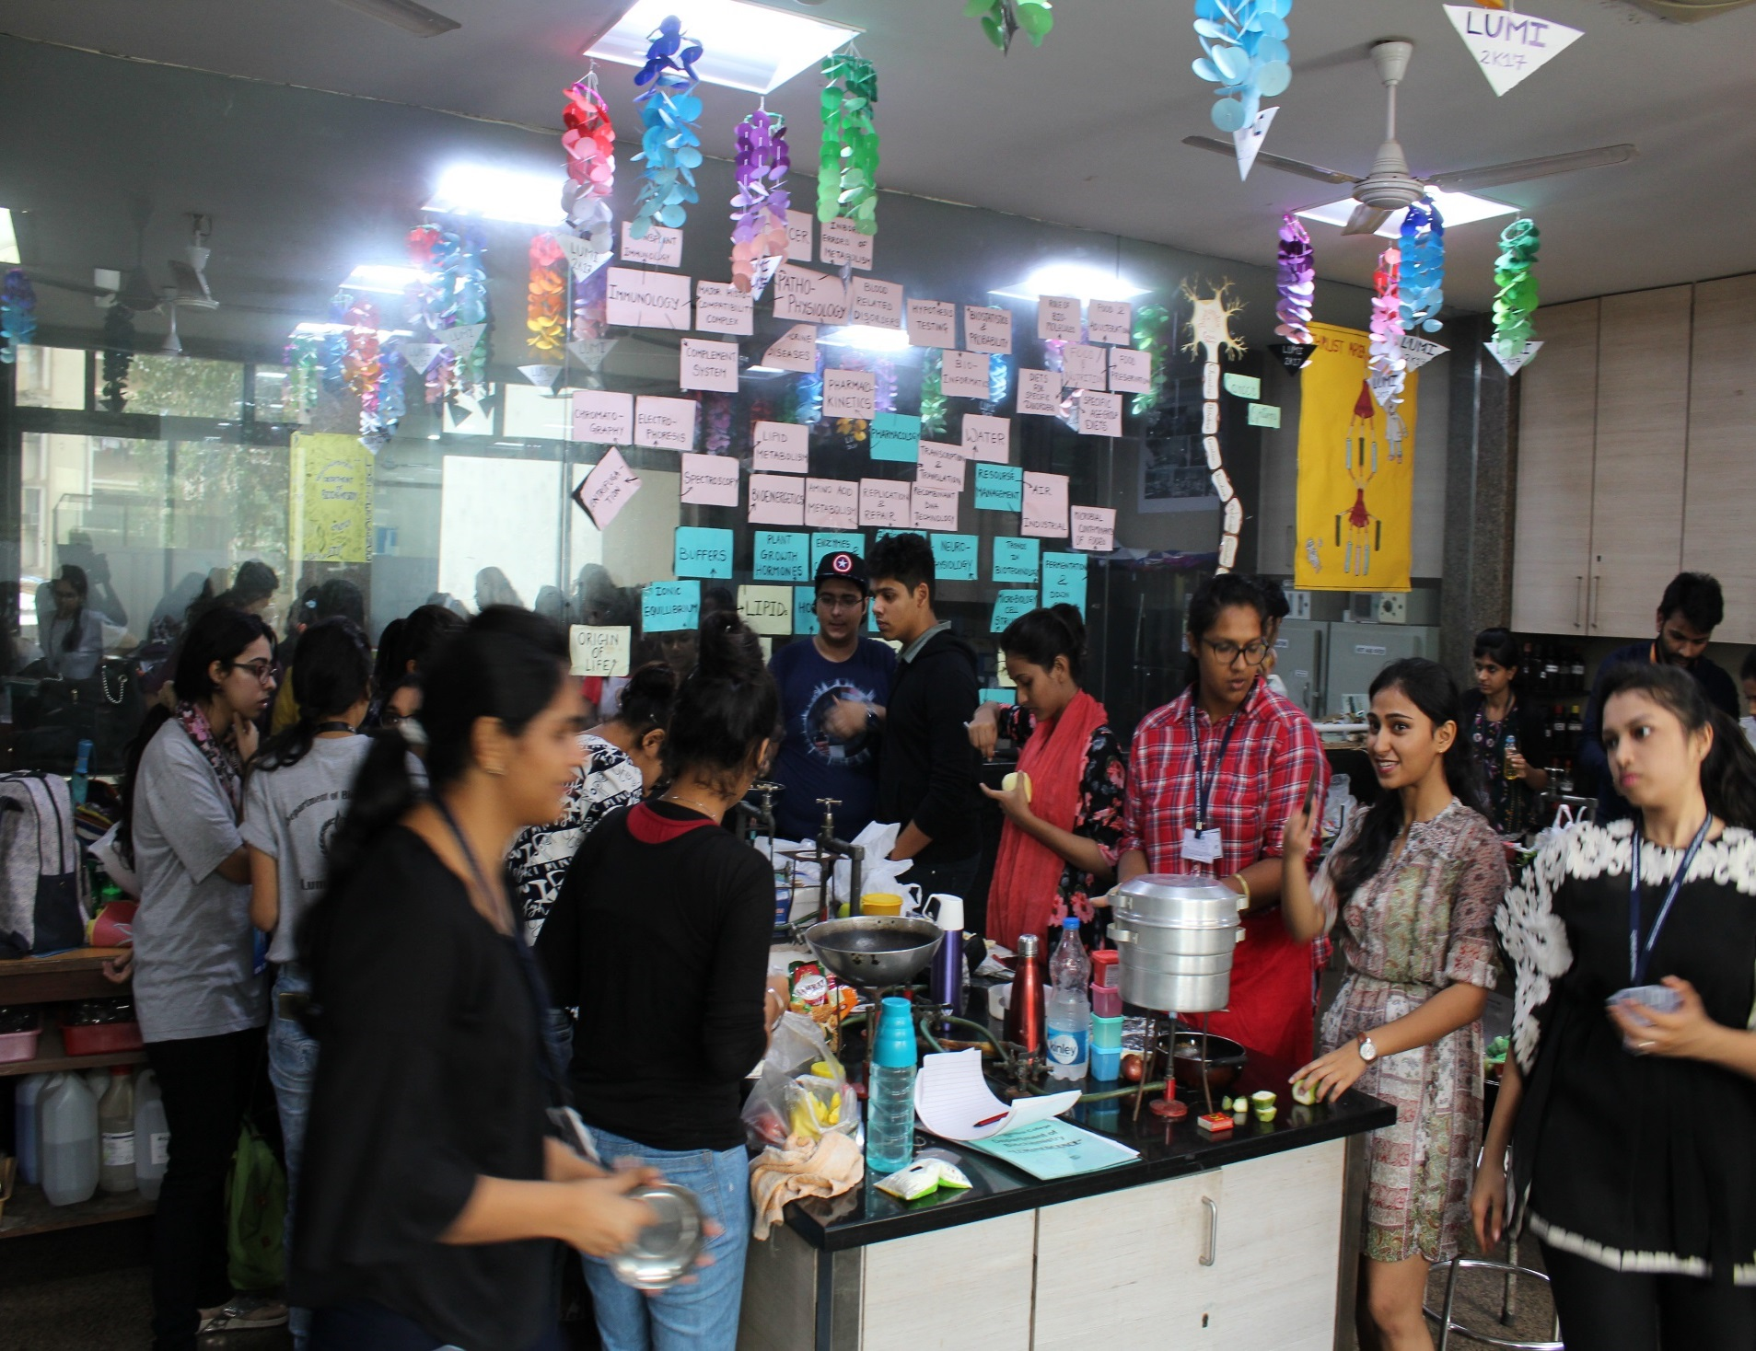
Mind Chef Competition at Luminescence 2017

Slide 26
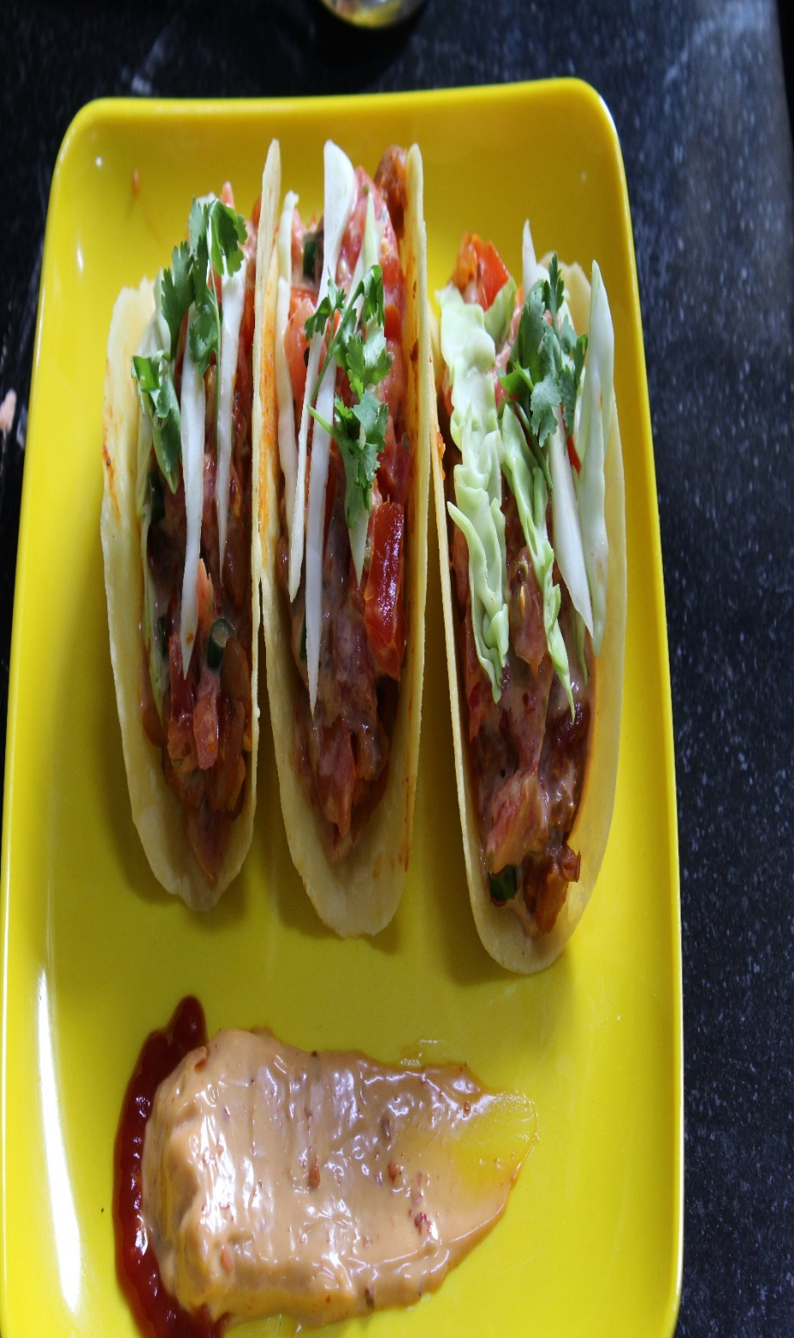
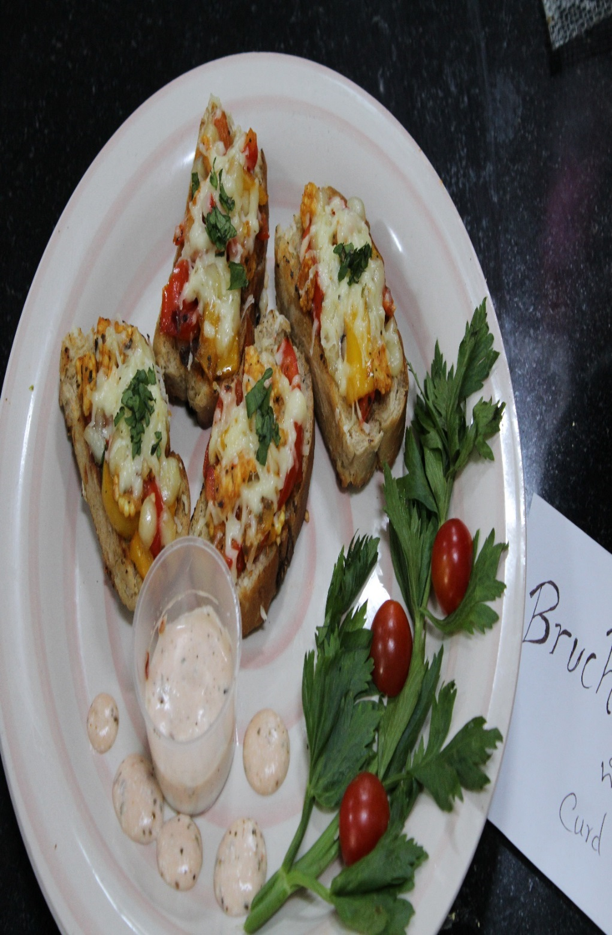

Slide 27
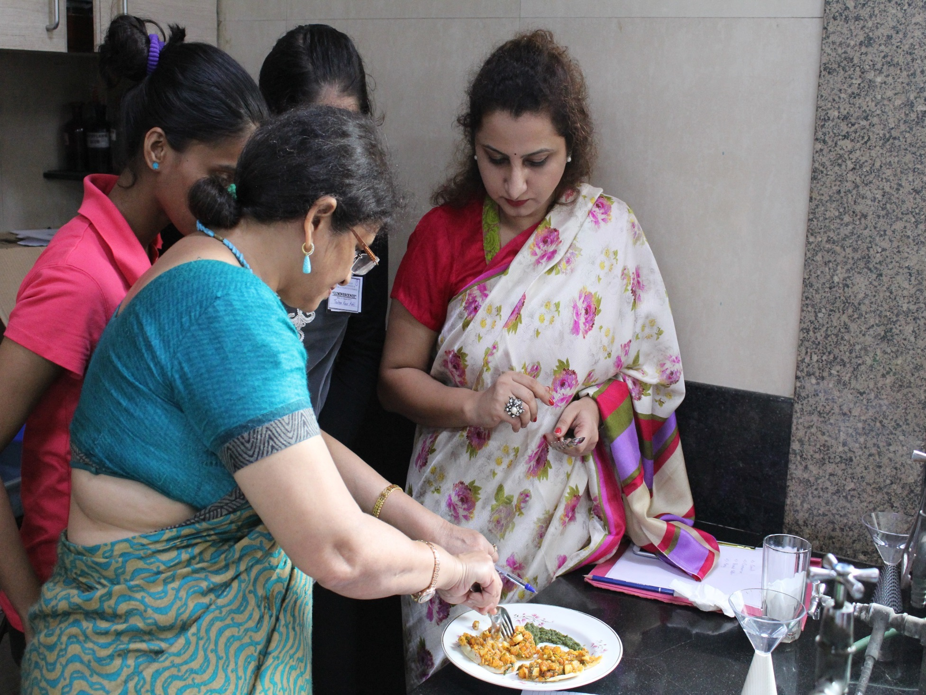
Judges at Mind Chef (Cooking) Competition at Luminescence 2017

Slide 28
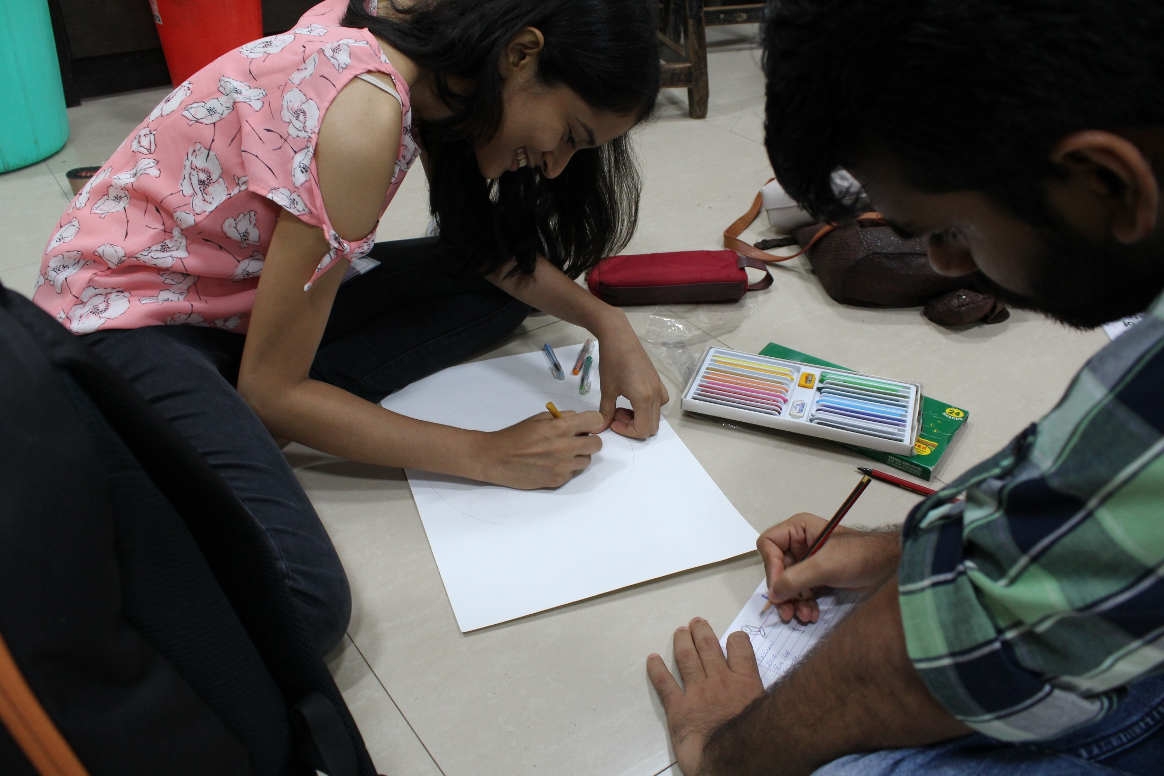
Logo Lego competition at Luminescence 2017

Slide 29
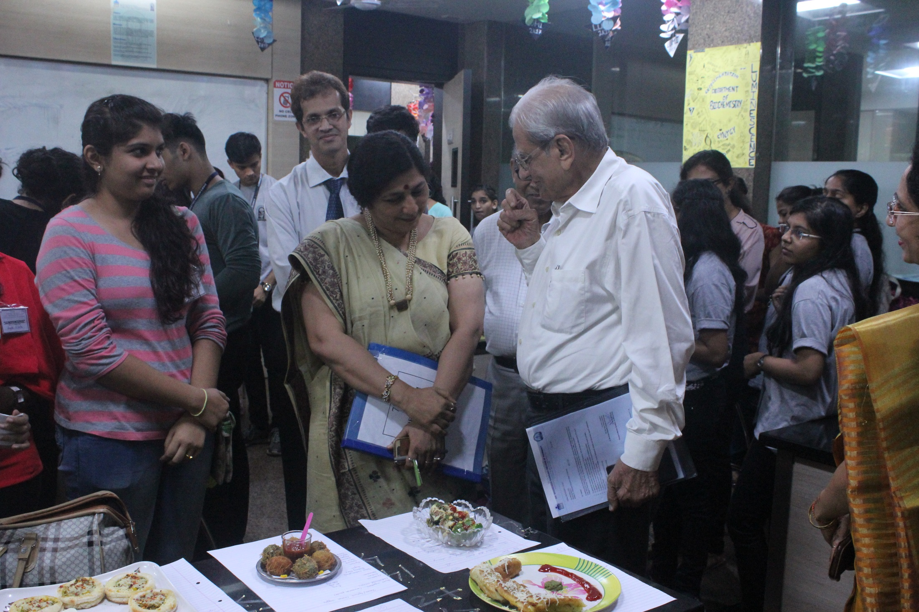
Mentor Mithibai College, Shri Sunandan Divatia at Luminescence 2017

Slide 30
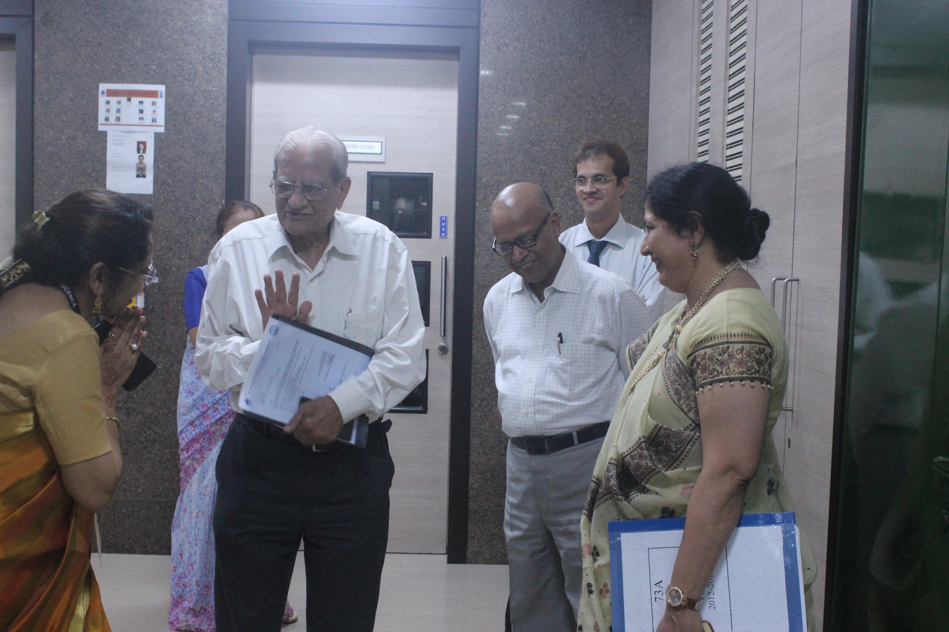
Mentor Mithibai College, Shri Sunandan Divatia, Shri Asoke Basak, CEO-SVKM, Principal NM College Dr Parag Ajgaonkar and Vice-Principal NM College Ms Amee Vora at Luminescence 2017

Slide 31
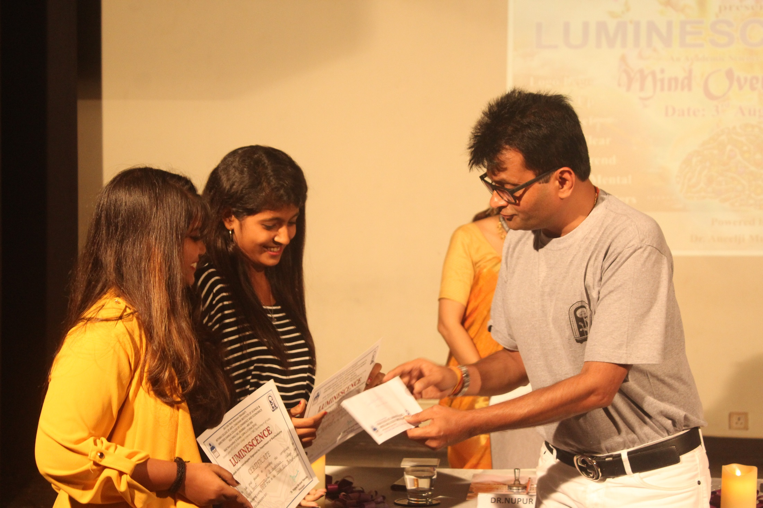
Winners being Felicitated by Chief Guest Shri Aneelji Murarka at Luminescence 2017

Slide 32
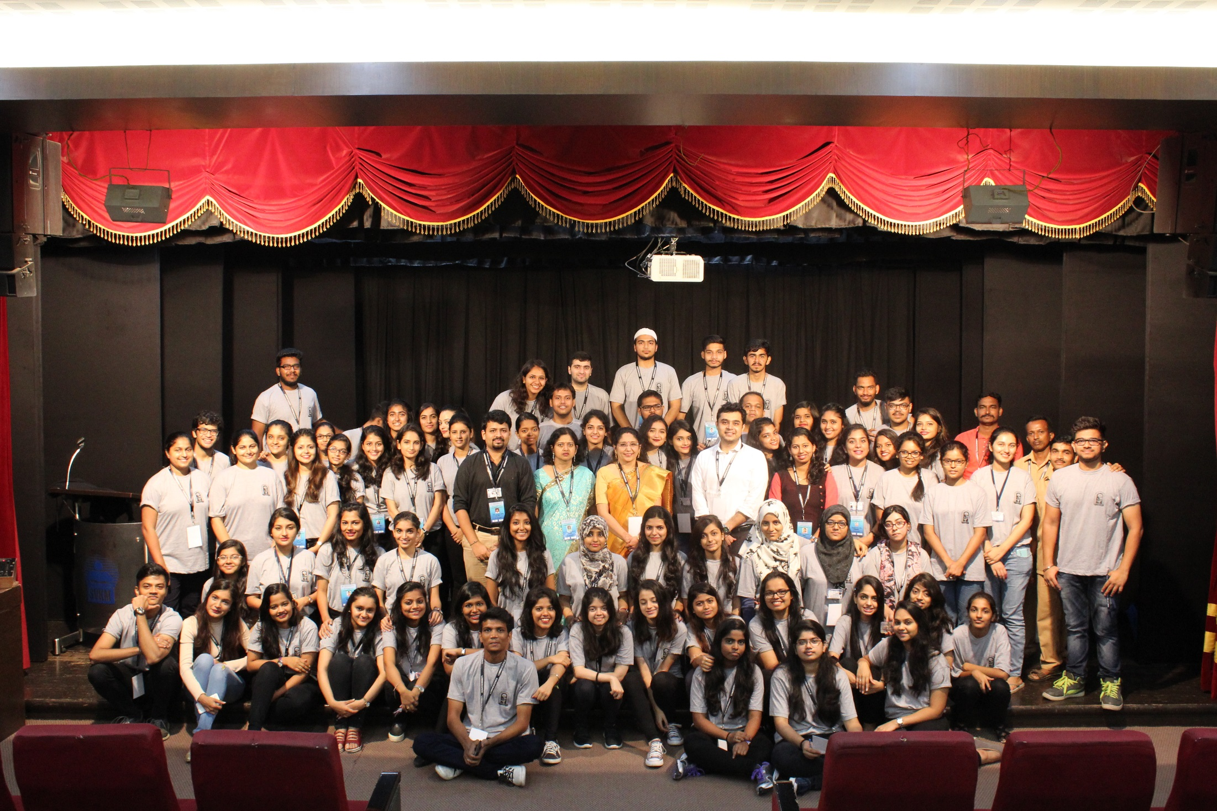
Team Luminescence 2017

Slide 33
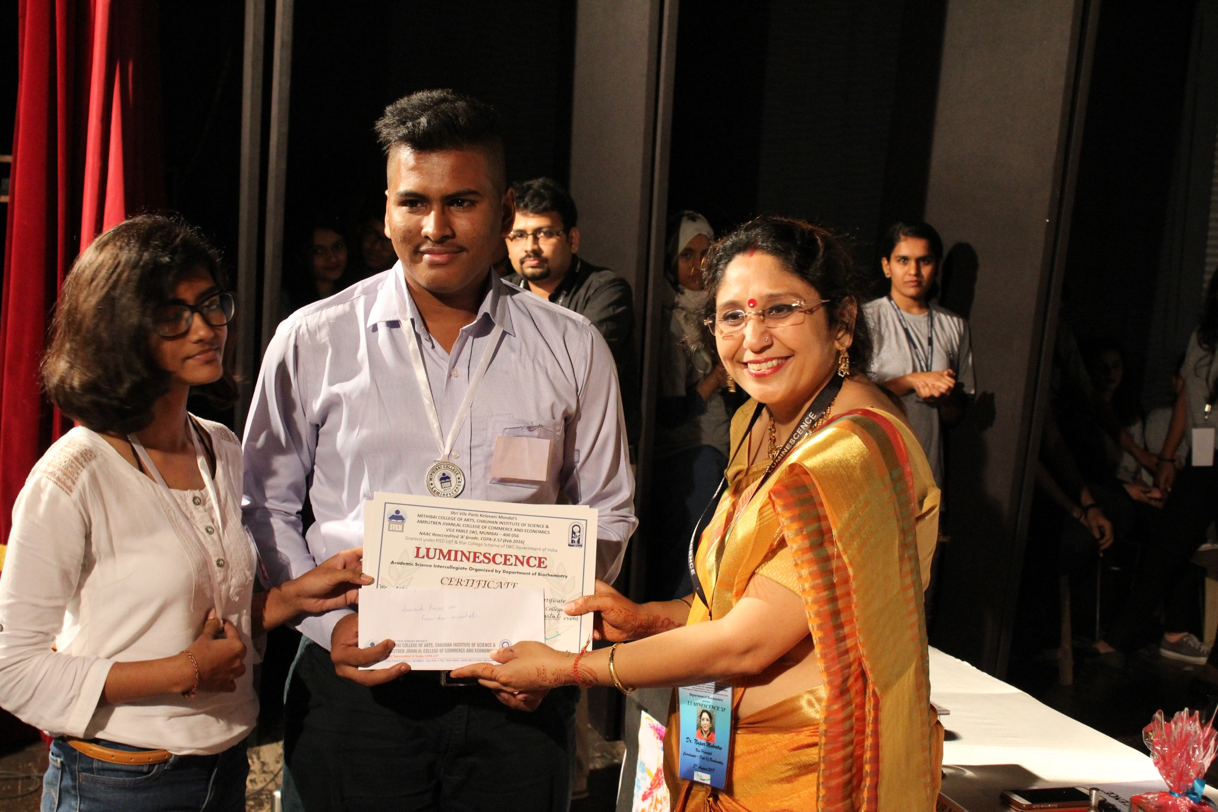
Winners being Felicitated by Vice Principal Self Financed Courses Dr Nupur Mehrotra at Luminescence 2017

Slide 34
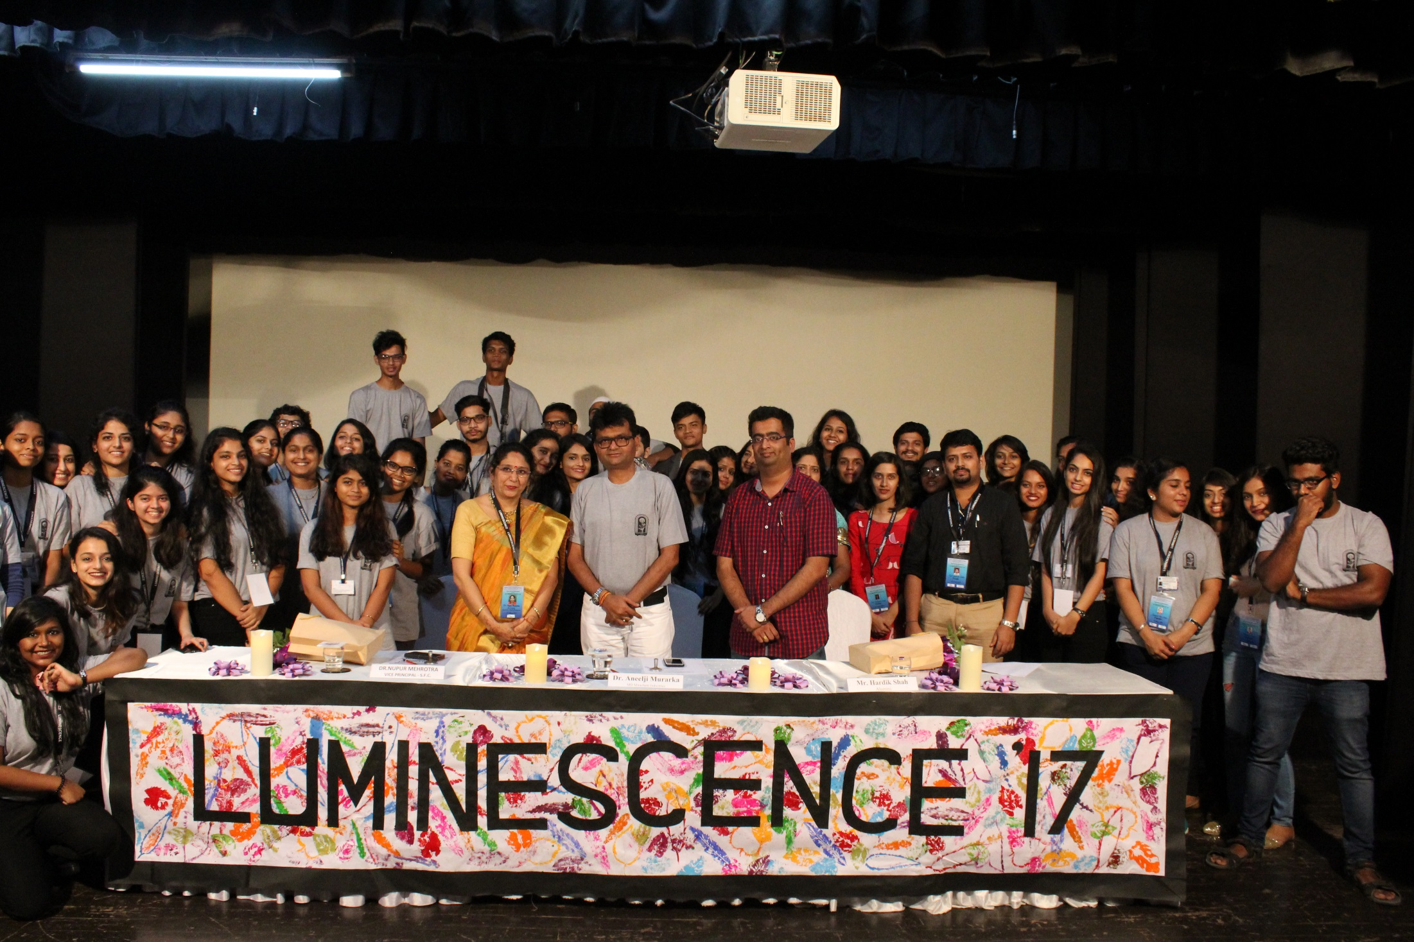
Team Luminescence 2017

